Slide 1
Production Module for e-Global Enterprise Resource Planning (ERP)
Company Project Guide :
Mr. Satish Nishad
SUBMITTED BY
MISS. Rajput Anuprita Sanjiv
SEAT NO: 213351036
M.Sc. SEM IV
(2021-2022)
College Project Guide :
Prof. Satish Ambike

Slide 2
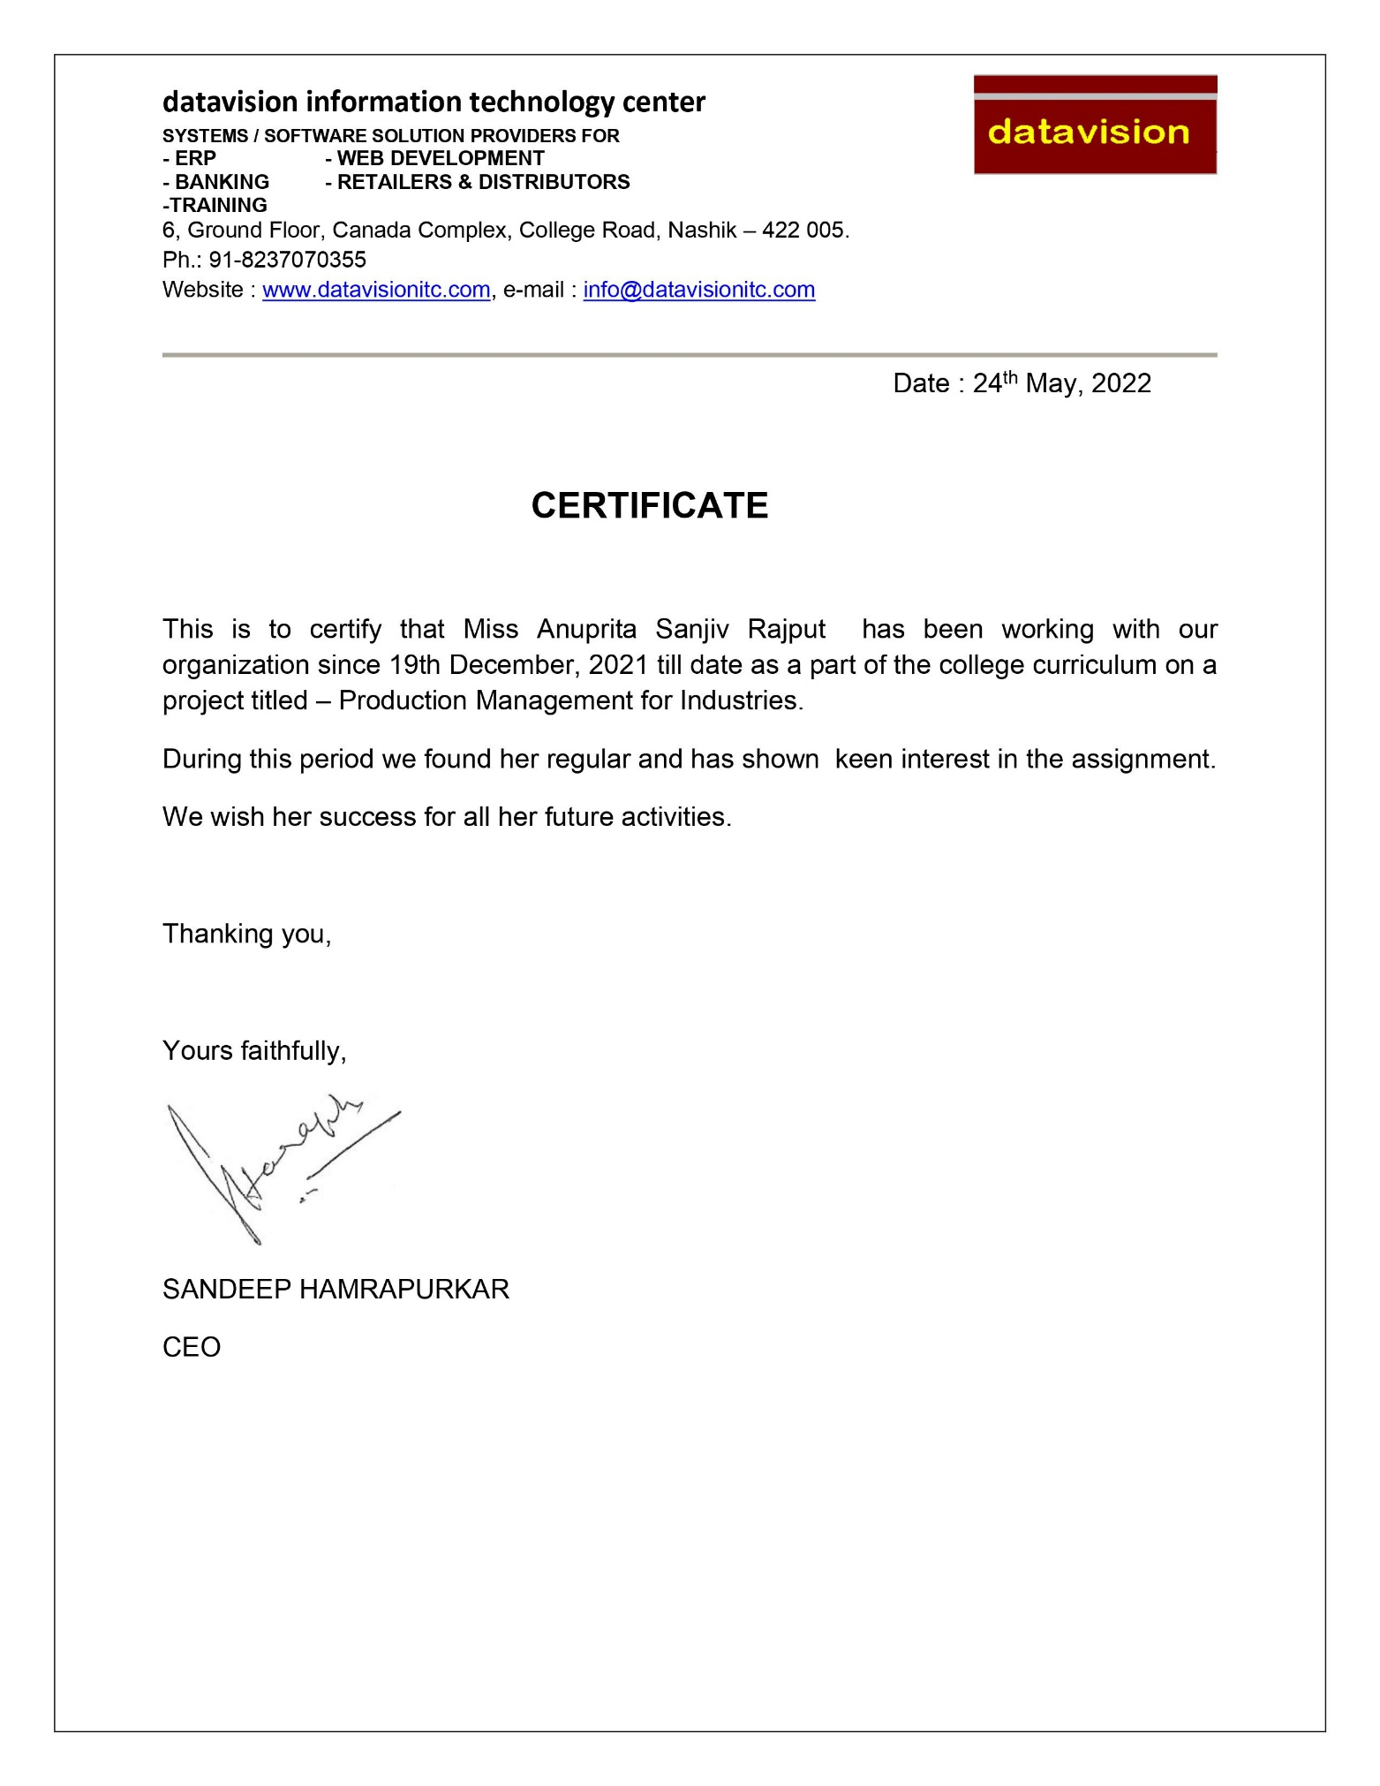

Slide 3
PROJECT PROGRESS REPORT
Name of Student | Miss. Anuprita Sanjiv Rajput
Title of Project | Production module for E-Global Enterprise resource Planning(ERP)
Company’s Project Guide Name | Mr. Satish Nishad
Sr.no | From date | To Date | Activity | Signature of Project Guide
1 | 19-12-2021 | 17-02-2022 | Training
2 | 18-02-2022 | 25-02-2022 | Analysis
3 | 26-02-2022 | 03-03-2022 | Information Research
4 | 04-03-2022 | 15-03-2022 | Project Management
5 | 16-03-2022 | 24-03-2021 | Database Creation
6 | 25-03-2022 | 08-04-2022 | UI Design
7 | 09-04-2022 | 30-04-2022 | Implementation Coding
8 | 02-05-2022 | 10-05-2022 | Testing

Slide 4
Introduction
“e-Global ERP” which proves to be the perfect solution for the
Production Industry by helping organizations optimize their operational
benefits through inventory control and management reporting.
“e-Global ERP” is a suite of application software designed for the
Production Industry. If you are a manufacturer of Production, Make
Planning, Goods or Finished Production, our ERP allows you to save costs,
eliminate errors and stay ahead of your competition.
Production module is mainly designed to monitor day-to-day production
progress. On completion of any work order information will be passed on to
dispatch for delivery. Reports on delivery schedule will be available in this
module.
The main objective of production management is to produce goods
and services of the right quality, right quantity, at the right time and at
minimum cost.
It is the processes of effectively planning, coordinating and controlling
the production that is the operations of that part of an enterprise, it means
to say that production and operations Management is responsible for the
actual transformation of raw materials into finished products.

Slide 5
Process of Production: Converting planned order to production order Releasing the production order Goods Issue for production order Confirmation of production order
Types of production:
The organization of manufacturing systems, also planning and control of production greatly depends on type of product of the product line.
Basic principles that guide the formation of planning policy and its execution may be the same for all the manufacturing concerns. But emphasis on a particular aspect of production management in fulfilling of specific requirement of the plant and the management approach to the problems of inventory, machine selection, machine setting, tooling,
Routing, scheduling, loading, follow up and general control will differ depending on the type of production system. Three main factors generally determine these aspects are:
1)Size of the Plant i.e., Small Industry, Medium sized Industry or Large Industry.
2) Type of production i.e., quantities of finished products and regularity of manufacture. For example whether Job production or Batch Production or Continuous Production.

Slide 6
Type of Production: In general there are three classifications in types of Production system. They are discussed below. Job Production Batch Production Continuous Production
Job Production:
In this system Products are manufactured to meet the requirements of a specific order. The quality involved is small and the manufacturing of the product will take place as per the specifications given by the customer.
This system may be further classified as -
The Job produced only once:
Here the customer visit the firm and book his order. After the completion of the product, he takes delivery of the product and leaves the firm. He may not visit the firm to book the order for the same product. The firm has to plan for Material, Process and Manpower only after receiving the order from the Customer. The firms have no scope for pre-planning the production of the product.
The job produced at irregular intervals:
Here the customer visits the firm to place orders for the same type of the product at irregular intervals. The firm will not have any idea of customer’s visit. Here also planning for materials, process and manpower will start only after taking the order from the customer. In case the firm maintains the record of the Jobs Produced by it, it can refer to the previous plans, when the customer arrives at the firm to book the order.
The Jobs Produced periodically at regular intervals:
In this system, the customer arrives at the firm to place orders for the same type of product at regular intervals. Here firm knows very well that the customer visits at regular intervals, it can plan for materials, and process and manpower and have them in a master file. As soon as the customer visits and books the order, the firm can start production. If the volume of the order is considerably large and the number of regularly visiting customers are large in number, the Job Production system slowly transform into Batch Production system.

Slide 7
Batch Production: Batch Production is the manufacture of number of identical products either to meet the specific order or to satisfy the demand. When the Production of plant and equipments is terminated, the plant and equipment can be used for producing similar products. This system also can be classified under three categories –
A batch produced only once:
Here customer places order with the firm for the product of his specification. The size of the order is greater than that of job production order. The firm has to plan for the resources after taking the order from the customer.
A Batch produced at irregular intervals as per Customer order or when the need arises:
As the frequency is irregular, the firm can maintain a file of its detailed plans and it can refer to its previous files and start production.
A Batch Produced periodically at known Intervals:
Here the firm either receives order from the customer at regular intervals or it may produce the product to satisfy the demand. It can have well designed file of its plans, material requirement and instructions for the ready reference. It can also purchase materials required in bulk in advance. As the frequency of regular orders goes on increasing the Batch Production system becomes Mass Production System. Here also, in case the demand for a particular product ceases, the plant and machinery can be used for producing other products with slight modification in layout or in machinery and equipment.

Slide 8
Continuous Production: Continuous Production system is the specialized manufacture of identical products on which the machinery and equipment is fully engaged. The continuous production is normally associated with large quantities and with high rate of demand. Hence the advantage of automatic production is taken. This system is classified as
Mass Production:
Here same type of product is produced to meet the demand of an assembly line or the market. This system needs good planning for material, process, maintenance of machines and instruction to operators. Purchases of materials in bulk quantities is advisable.
Flow Production:
The difference between Mass and Flow Production is the type of product and its relation to the plant. In Mass Production identical products are produced in large numbers. If the demand falls or ceases, the machinery and equipment, after slight modification be used for manufacturing products of similar nature. In flow production, the plant and equipment is designed for a specified product. Hence if the demand falls for the product or ceases, the plant cannot be used for manufacturing other products. It is to be scraped.
The examples for the above discussed production system are:
Job Production Shop:
Tailors shop; cycle and vehicles repair shops, Job typing shops, small Workshops.
Batch Production Shop:
Tire Production Shops, Readymade dress companies, Cosmetic manufacturing companies...etc.
Mass Production Shops:
Components of industrial products,
Flow Production:
Cement Factory, Sugar factory, Oil refineries...etc.,

Slide 9
PROBLEM DEFINITION
Now a day, the world is making progress rapidly. People want everything very fast. The 21st century people are getting comfortable with fast food. They want everything on a flick of click, whatever may be the thing. Whether it is in terms of food, travelling, earning money, transporting, ordering products etc.
This system is developed so that with the help of this, we can interact with the company or client located to any location within few seconds that avoids paper work and it is very cheap as compared to traditional system, and hence it is very fast.
Existing system is desktop based application and any retail or organization wants it to be web based so in order to acquire new facility.
Existing system is not centralized. It only works on local or client and we want it to work on both client and server.

Slide 10
System
Existing System
The existing Production is the totally manual system. Company uses the system which is prepared in FoxPro or ERM. To handle the system user must familiar with MS DOS or user must know all commands related this system.
To create any transaction such as generate Bill Of Material searching any report, deleting, printing etc. User needs to give specific commands for each and every transaction so only well-known person only create cutting plan, generate material issue slip , stock updating, Issue Notes, production entry, inspection details etc.
Existing System Limitation:
Only well-known person can handle this system.
For any operation give commands it is time consuming and lengthy process.
The Present system is very less secure.
It is unable to generated different kind of reports
Proposed System
In the web based application for managing the production process for Production Industry the module begins with product. This module will be used for whole production process to be digitized. Production planning helps an organization to plan production with the optimum utilization of all available resources. Feasibility of production is evaluated using details like raw material availability and procurement time, machine availability and capacity.
Advantages of Proposed System:-
The proposed system is intended to avoid all the drawbacks of existing system. It will add some more features than the existing system. The proposed system is a cost effective way of doing the manual processes done in the existing system. This helps the organization to win the war in the existing competitive world.
The proposed system is intended to do the following:
Enable to meet challenges
Prepare and produce accurate outputs
Reduce the time needed
Reduce the expenses
Make information flow efficient
Easy report generation
Attractive user Interface

Slide 11
Required Analysis
Server Side Specification
Hardware Specifications
Processor with high capacity.
Hard disk having storage capacity in GBs.
UPS
High bandwidth Internet Connection
Software Specifications
Client Side Configuration
Client Side Specification
Hardware Specifications
Processor: Dual Core or above
Hard-disk: 100 GB or above
RAM: 2GB or above
Internet Connection
Software Specification
Microsoft Windows 7 Ultimate or above
Web browsers i.e. Google Chrome, Mozilla .etc

Slide 12
Scope of the system
Material Management:
The Purchases Module has Purchase Requisition, Quotation, Purchase Order, Gate Entry, GRN, and Purchase Invoice Respectively. GRN is Further Inspected and further added to the stock in other case it is Rejected and Sent Back to supplier.
Production Management:
The Production Module has Part Master, Bill of Material, Routing, Sales Order with Production Quantity, Production Plan, MRP, Purchase Requisition, Material Requirement, Material Issue with BOM and Routing, Job Order Release, Actual Production and Invoice Respectively.

Slide 13
Operating environment
Front End : # Asp.Net 4.0
Back End : SQL Server 2008
Deployment environment:
Hardware | Software
Processor: Dual Core or Above | OS: Win XP onwards
RAM: 2 GB Min. | Framework: .NET framework 4.0
Disk: Min. 40 GB | Database: SQL Server 2008
Development Environment:
Hardware | Software
Processor: Pentium IV or Above | OS: Win XP onwards
RAM: 2 GB Min. | Development Tool: MS Visual Studio 2015
Disk: Min. 80 GB

Slide 14
Feasibility Study
A feasibility analysis usually involves a thorough assessment of the operational (need), financial and technical aspects of a proposal. Feasibility study is the test of the system proposal made to identify whether the user needs may be satisfied using the current software and hardware technologies, whether the system will be cost effective from a business point of view and whether it can be developed with the given budgetary constraints. A feasibility study should be relatively cheap and done at the earliest possible time. Depending on the study, the decision is made whether to go ahead with a more detailed analysis.
Operational Feasibility Study :-
The system “Production Management Module” is user friendly one. Whenever a user wants to perform whatever kind of operation regarding with its products he can perform It very easily. If in case there is any problem then there is a provision for help in the form of manual which gives him a step by step procedure follow-up.
Technical Feasibility Study:-
The system is web based in which the developer makes use of ASP.Net language. Whatever kind of connectivity needed for respective project is being done through coding. Also there are some validation used for security purpose, i.e. unless user enters its login name and password correctly he will not get connected to the server. Also worker test the finished product by using external algorithmic system for calculating OK and damaged quantities, also store the backup of the database for secure manner, etc.
Economical Feasibility Study:-
The system is developed considering the wide range of customers requirements. The system is developed considering the customers for whom time factor is very much of importance and also having a fast service for whatever they are paying for. Basically the system is not much of high range of cost; it can be used by the customers who search for facilitation in their work.

Slide 15
Objective of System
Faster response time.
Ability to meet user requirements.
Flexibility.
Reduced dependency.
Improves resource uses.
Reduction in use of the paper.
Reduction in Man Power.
To purchase quality goods at minimum cost
Manage all the records efficiently.
Reduces errors.
To exercise control over Stock.
To Generate Required Reports.
To maintain the efficiency of Sales And Purchase department
Reduction in processing cost.
Error reduction.

Slide 16
System Analysis and Design

Slide 17




Entity Relation Diagram (Admin)
Admin
1
Create & set accesss
M
Role
1
1
1
Assign
Create
M
M
User/Emp
Authenticate
M

Slide 18
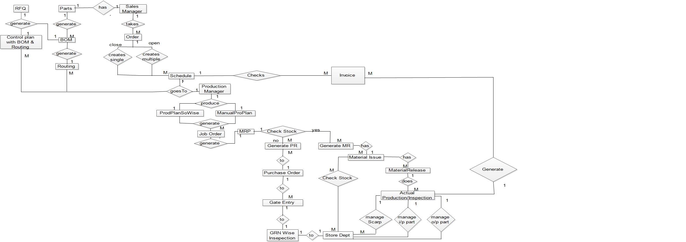
Entity Relation Diagram (Production)

Slide 19
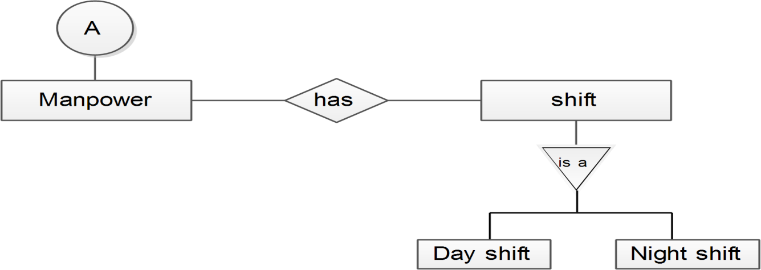
Entity Relation Diagram(Manpower)

Slide 20
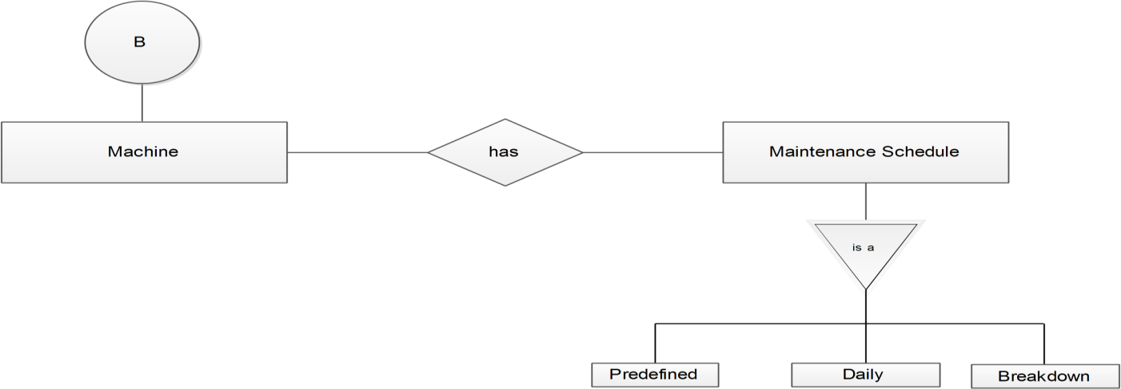
Entity Relation Diagram (Machine)

Slide 21
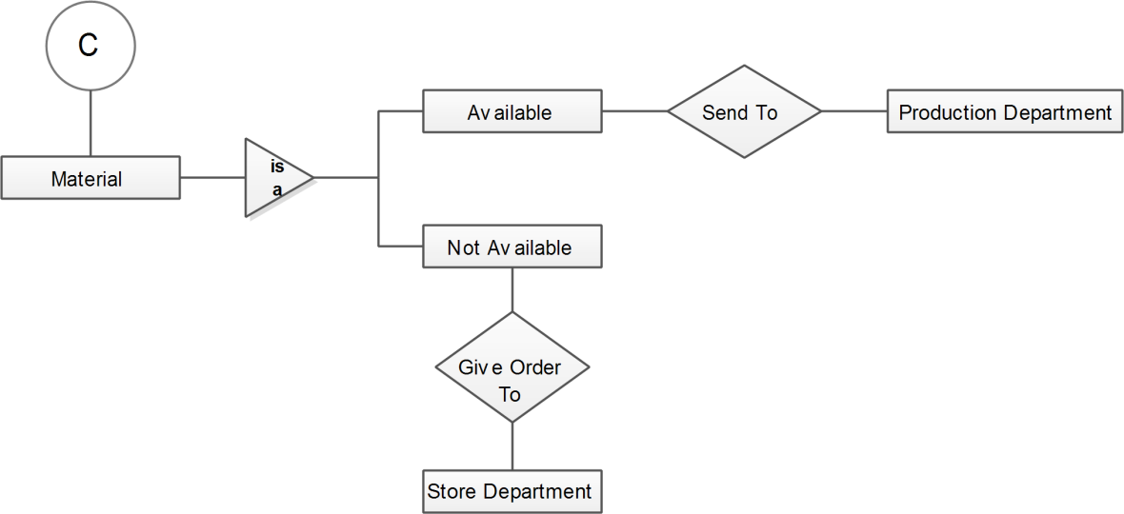
Entity Relation Diagram (Material)

Slide 22
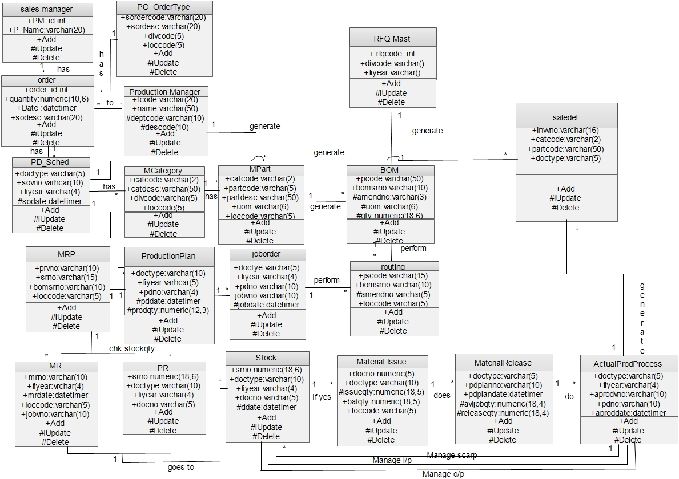
Class Diagram

Slide 23
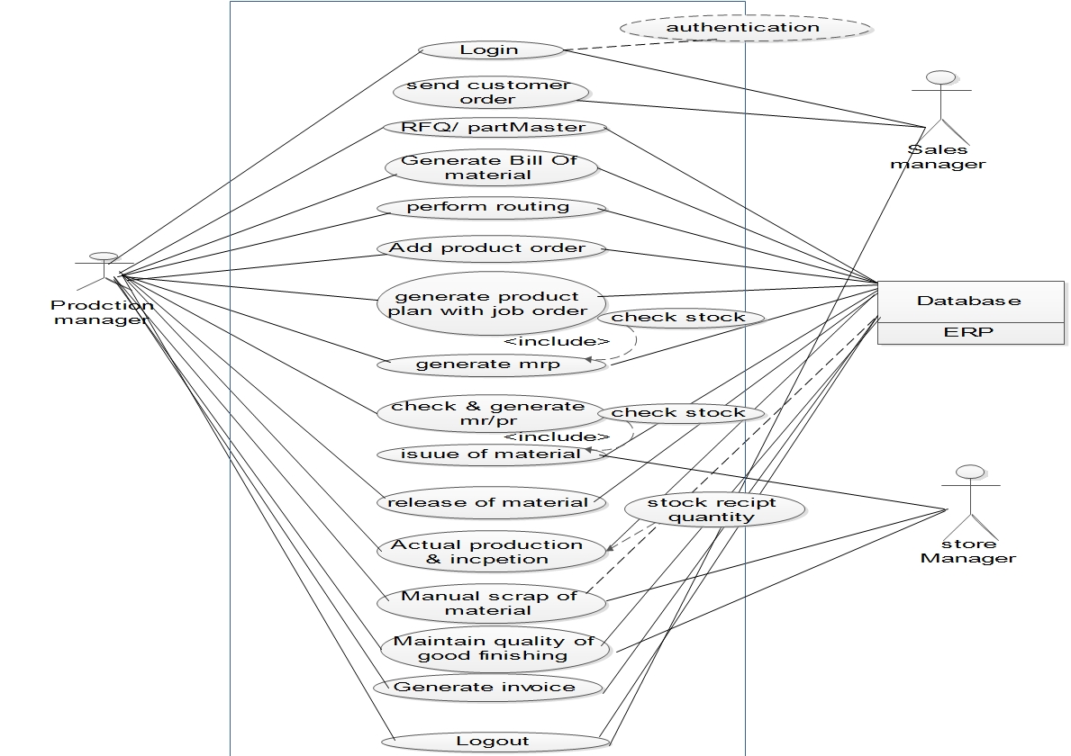
Use-Case Diagram

Slide 24
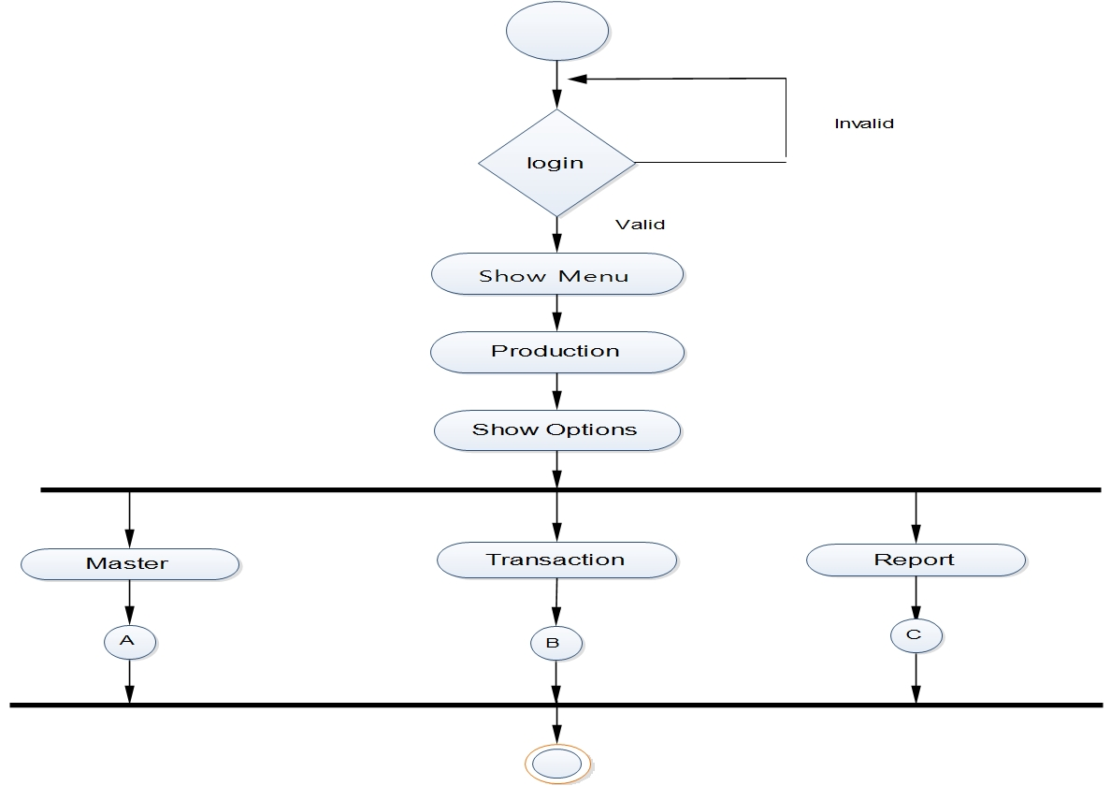
Activity Diagram

Slide 25
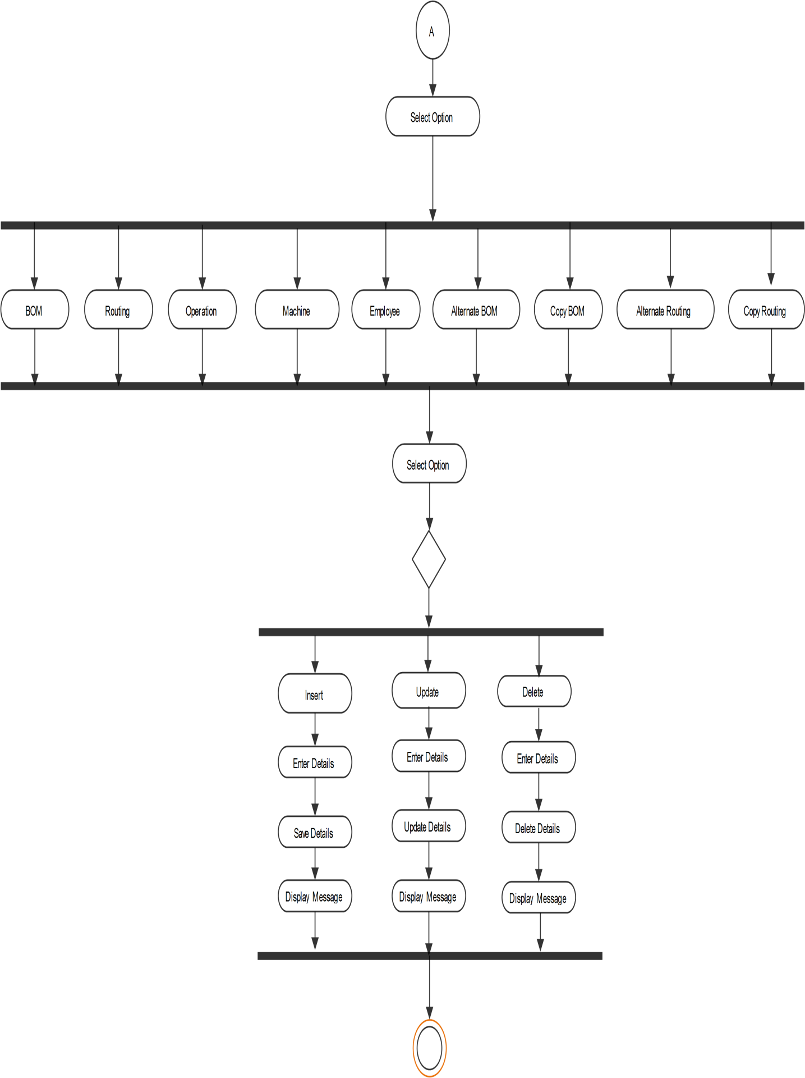
Activity Diagram (Master)

Slide 26
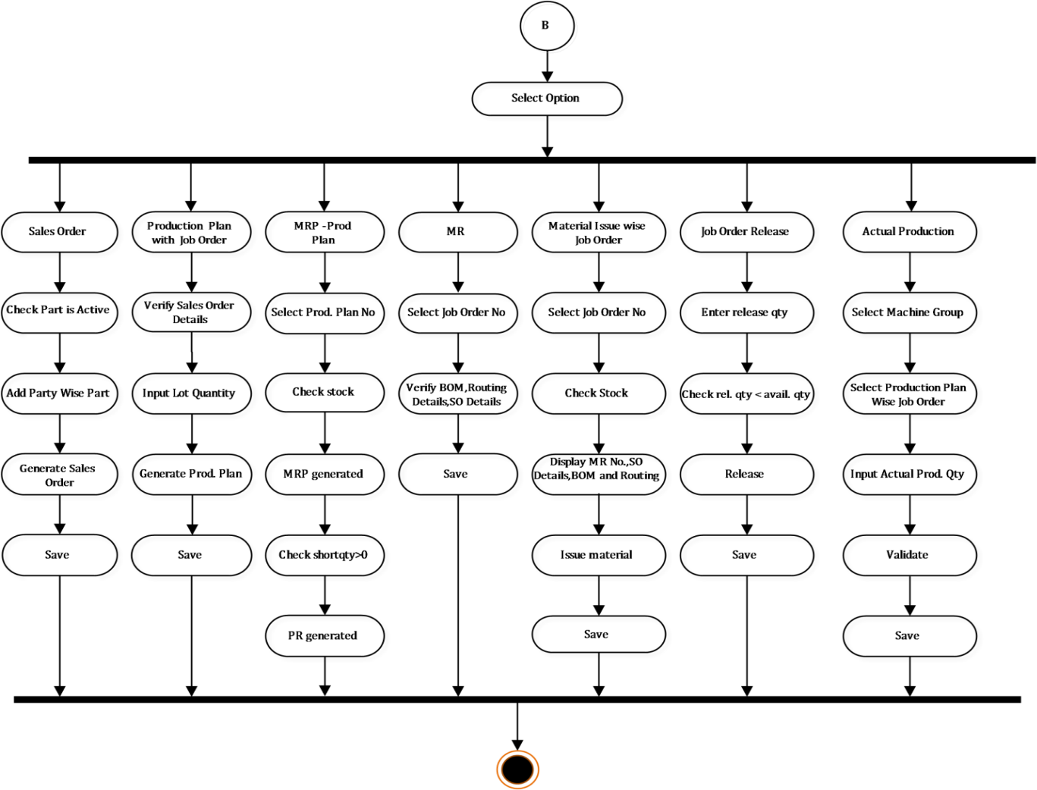
Activity Diagram For Transaction

Slide 27
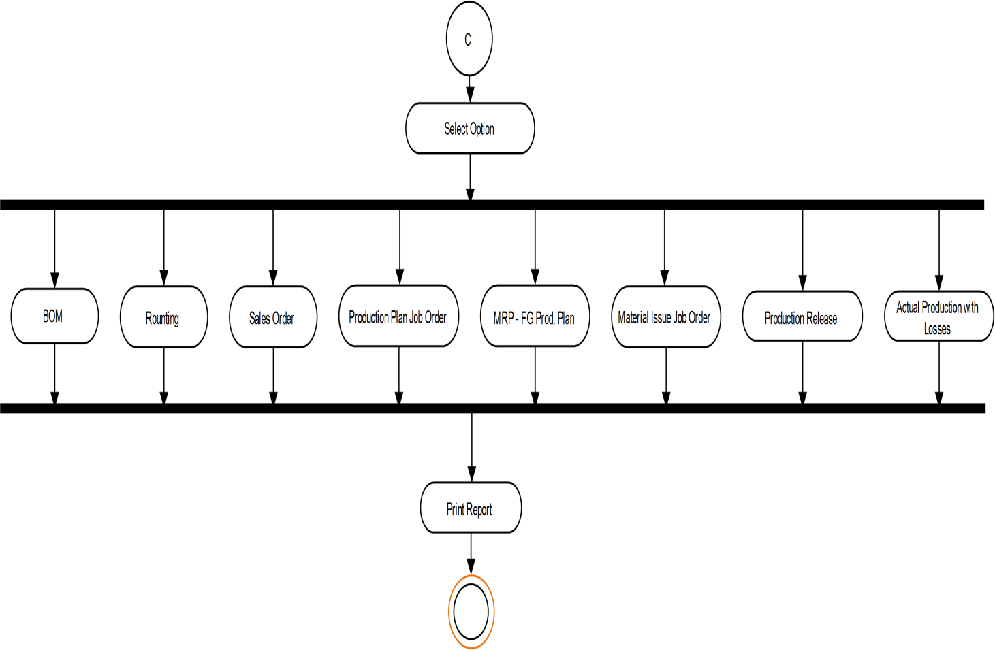
Activity Diagram For Report

Slide 28
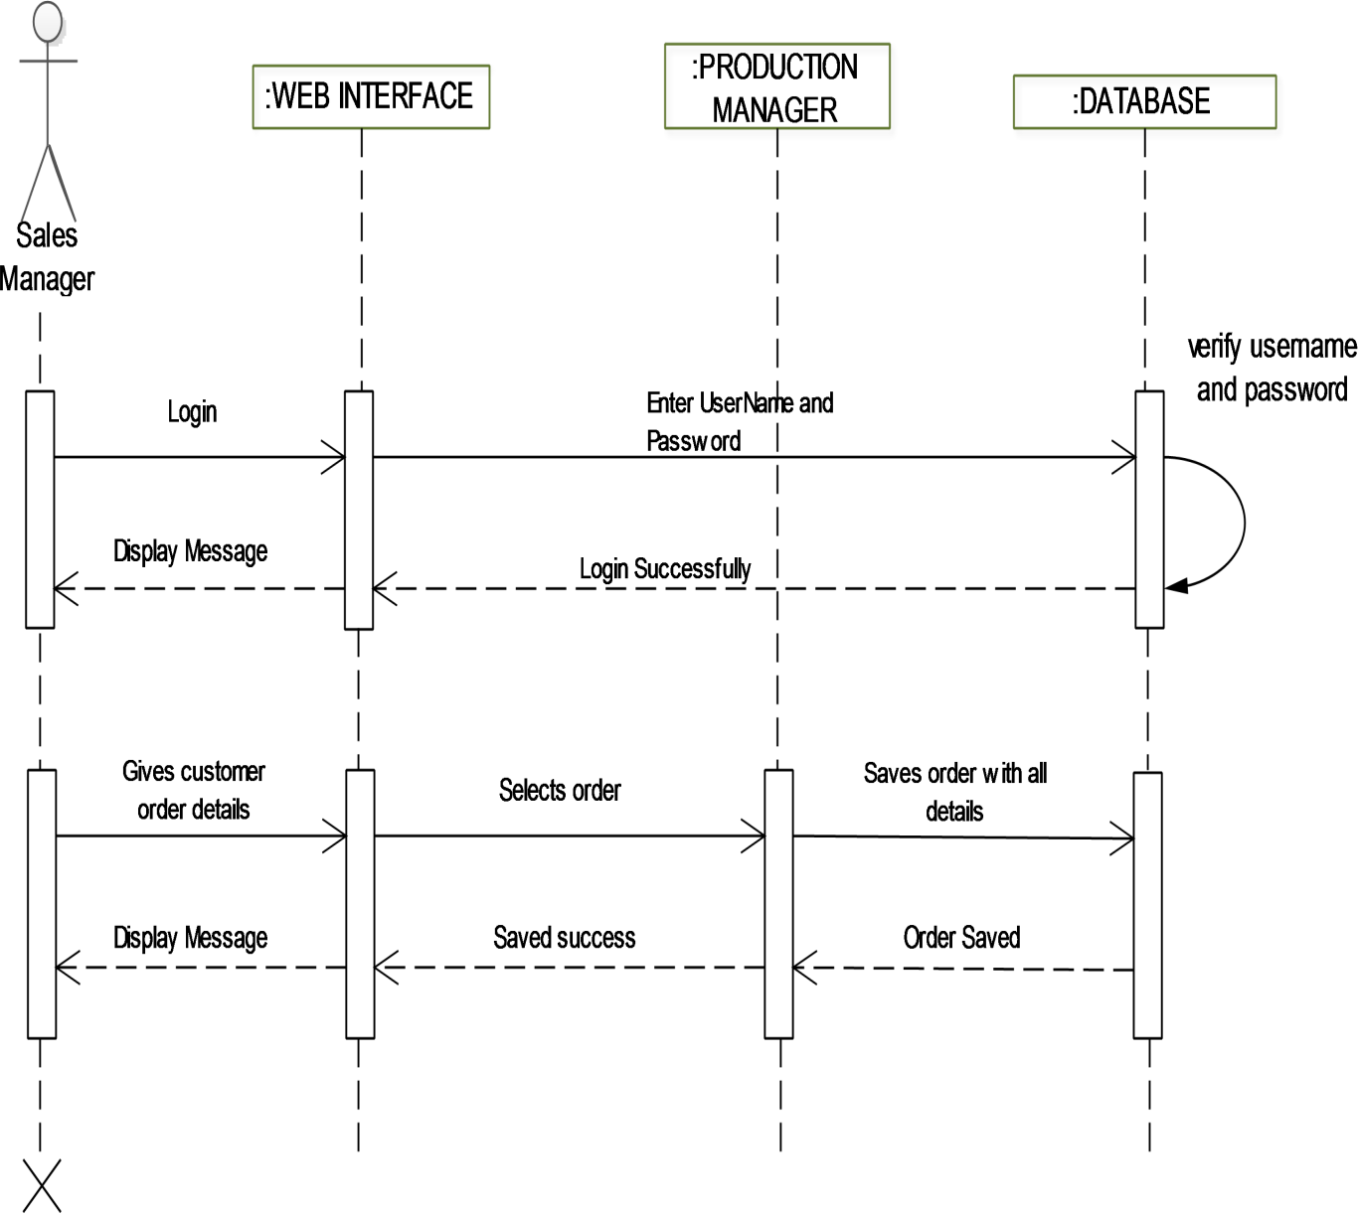
Sequence Diagram for Sale Manager

Slide 29
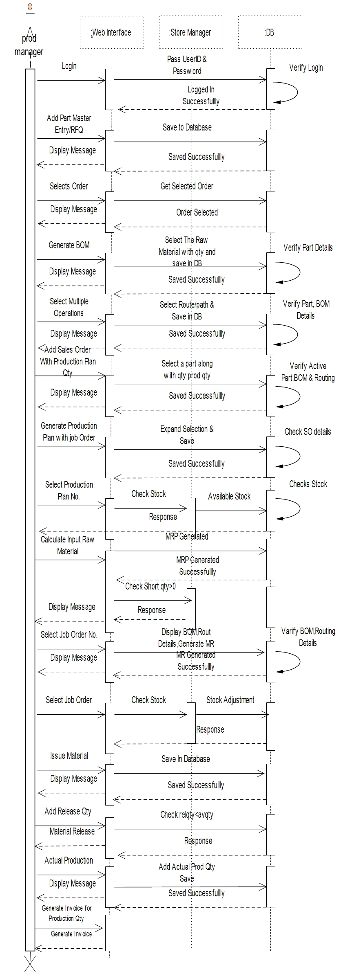
Sequence Diagram for Production

Slide 30
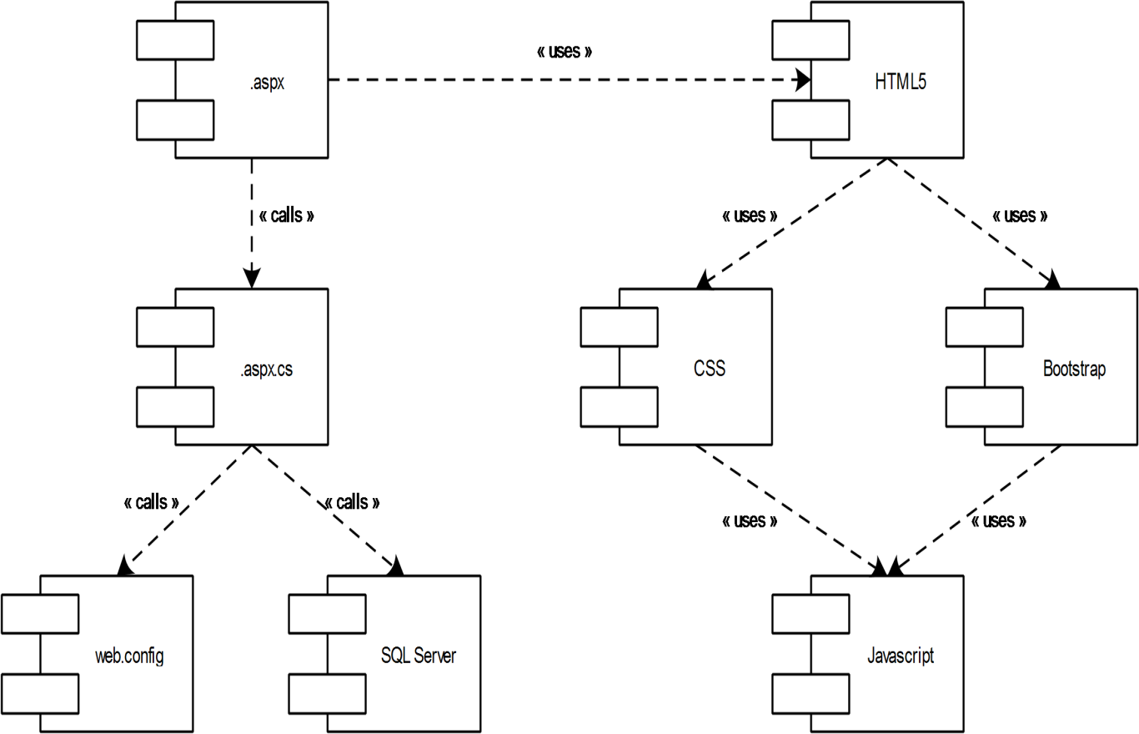
Component Diagram

Slide 31
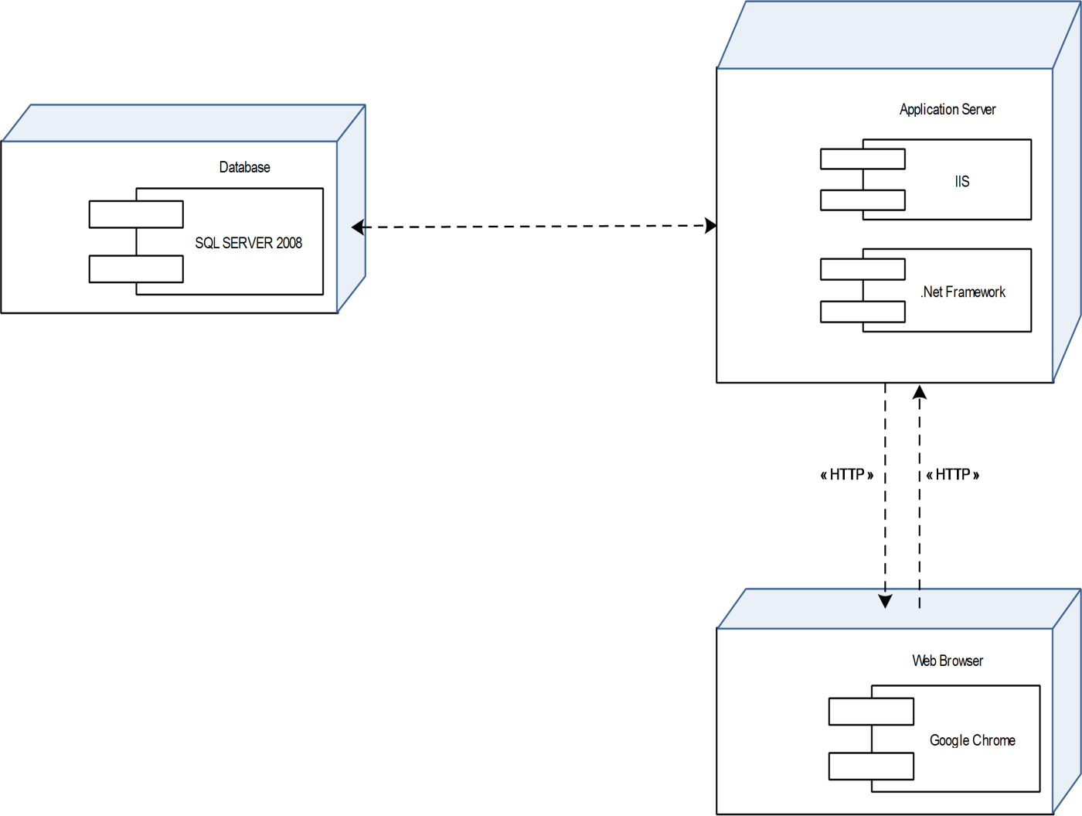
Deployment Diagram

Slide 32
Data Dictionary

Slide 33
Table Name: MPart
Field No | Field Name | Data Type | Constraint
1. | catcode | varchar(2) | Foreign Key
2. | partcode | varchar(50) | Primary Key
3. | partdesc | varchar(200)
4. | uom | varchar(6)
5. | iuom | varchar(6)
6. | basicrate | numeric(10,2)
7. | rateperqty | numeric(10,2)
8. | netweight | numeric(10,4)
9. | grossweight | numeric(10,4)
10. | scrapweight | numeric(10,4)
11. | actcode | varchar(5)
12. | matcode | varchar(20)
13. | sgcode | varchar(20)
14. | classNo | varchar(20)
15. | obsolete | varchar(1)
16. | accode | varchar(10)
17. | exflag | varchar(3)
18. | divcode | varchar(5) | Foreign Key
19. | loccode | varchar(5) | Foreign Key
20. | clicode | varchar(5) | Foreign Key
21. | userid | varchar(100)

Slide 34
22. | sysdate | datetimer
23. | reordqty | numeric(10,2)
24. | custdrawno | varchar(50)
25. | ratio | numeric(10,2)
26. | exciseclassification | varchar(20)
27. | minstockqty | numeric(10,2)
28. | maxstockqty | numeric(10,2)
29. | ippartdesc | varchar(100)
30. | Oppartdesc | varchar(100)
31. | width | numeric(10,2)
32. | length | numeric(10,2)
33. | Sqrmtrs | numeric(10,2)
34. | hsncode | varchar(8)
35. | hsnchapterno | varchar(15)
36 | ImageName | varchar(200)
37 | ImagePath | varchar(1000)
38. | RawMaterialDescCust | varchar(200)
39. | RMGrade | varchar(50)
40. | Shape | varchar(50)
41. | Thickness | numeric(10,2)
42. | ItemCode | varchar(50)
43. | BOMtype | varchar(1)
44. | IsActive | bit

Slide 35
Table Name : MCategory
Field No | Field Name | Data Type | Constraints
1. | Catcode | varchar(2) | Primary Key
2. | Catdesc | varchar(50)
3. | Accode | varchar(10)
4. | Modvatflag | varchar(1)
5. | Divcode | varchar(5) | Foreign Key
6. | Loccode | varchar(5) | Foreign Key
7. | Clicode | varchar(5) | Foreign Key
8. | Userid | uniqueidentifier | Foreign Key
Table Name : MDocument
Field No | Field Name | Data Type | Constraints
1. | Doctype | varchar(5) | Primary Key
2. | Modcode | varchar(5)
3. | Docdesc | varchar(50)
4. | Usage | varchar(2)
5. | Subusage | varchar(3)
6. | Clicode | varchar(5) | Foreign Key

Slide 36
Table Name : MOperation
Field No | Field Name | Data Type | Constraints
1. | Oprcode | varchar(5) | Primary Key
2. | Oprdesc | varchar(255)
3. | TimeReq | decimal(10,2)
4. | Divcode | varchar(5) | Foreign Key
5. | Loccode | varchar(5) | Foreign Key
6. | Clicode | varchar(5) | Foreign Key
7. | Userid | Uniqueidentifier | Foreign Key
8. | Subcflag | char(1)
Table Name : MMachinegroup
Field no | Field Name | Data Type | Constraint
1. | MachineGroupCode | varchar(10) | Primary Key
2. | MachineGroupName | varchar(250)
3. | Divcode | varchar(5) | Foreign Key
4. | Loccode | varchar(5) | Foreign Key
5. | Clicode | varchar(5) | Foreign Key
6. | Userid | uniqueidentifier | Foreign Key

Slide 37
Table Name : MMachineGroupDetails
Field no | Field Name | Data Type | Constraint
1. | MachineGroupCode | varchar(10) | Primary Key
2. | MachineCode | varchar(250) | Foreign Key
3. | MachineName | varchar(250)
4. | Divcode | varchar(5) | Foreign Key
5. | Loccode | varchar(5) | Foreign Key
6. | Clicode | varchar(5) | Foreign Key
7. | Userid | uniqueidentifier() | Foreign Key
Table Name : pp_bom
Field no | Field Name | Data Type | Constraint
1. | catcode | varchar(2) | Foreign Key
2. | partcode | varchar(50) | Foreign Key
3. | Srno | varchar(10) | Primary Key
4. | amendno | varchar(3)
5. | Edate | Datetimer
6. | Vdate | Datetimer
7. | level0 | varchar(5)
8. | level1 | varchar(5)
9. | bomlevel | numeric(10,0)
10. | Uom | varchar(6)
11. | Qty | numeric(10,6)
12. | Weight | numeric(10,3)
13. | Clicode | varchar(5) | Foreign Key
14. | divcode | varchar(5) | Foreign Key
15. | loccode | varchar(5) | Foreign Key
16. | Userid | uniqueidentifier
17. | Jscode | varchar(10)
18. | Seqno | varchar(10)

Slide 38
Table Name : pp_bominput
Field no | Field Name | Data Type | Constraint
1. | srno | varchar(15) | Primary Key
2. | bomsrno | varchar(10) | Foreign Key
3. | catcode | varchar(2) | Foreign Key
4. | partcode | varchar(50) | Foreign Key
5. | ipcatcode | varchar(2) | Primary Key
6. | ippartcode | varchar(50) | Primary Key
7. | amendno | varchar(3) | Primary Key
8. | uom | varchar(6)
9. | qty | numeric(10,6)
10. | weight | numeric(10,3)
11. | wastageper | numeric(10,3)
12. | clicode | varchar(5) | Foreign Key
13. | divcode | varchar(5) | Foreign Key
14. | loccode | varchar(5) | Foreign Key
15. | userid | uniqueidentifier
16. | seqno | varchar(10)
17. | remark | varchar(300)
18. | oprcode | varchar(10)

Slide 39
Table Name : pp_jsmast
Field no | Field Name | Data Type | Constraint
1. | jscode | varchar(15) | Primary Key
2. | partcode | varchar(50) | Foreign Key
3. | catcode | varchar(2) | Foreign Key
4. | bomsrno | varchar(10)
5. | amendno | varchar(3)
6. | altbomno | varchar(3)
7. | edate | Datetimer
8. | vdate | Datetimer
9. | uom | varchar(6)
10. | qty | numeric(10,6)
11. | weight | numeric(10,6)
12. | clicode | varchar(5) | Foreign Key
13. | divcode | varchar(5) | Foreign Key
14. | loccode | varchar(5) | Foreign Key
15. | doctype | varchar(5) | Foreign Key
16. | fiyear | varchar(5) | Foreign Key
17. | userid | Uniqueidentifier
18. | activeflag | varchar(1)
19. | slcode | varchar(5)

Slide 40
Tabel Name : pp_jsdet
Field no | Field Name | Data Type | Constraint
1. | srno | int(10) | Primary Key
2. | seqno | int(10)
3. | jscode | varchar(15) | Foreign Key
4. | partcode | varchar(50) | Foreign Key
5. | catcode | varchar(2) | Foreign Key
6. | wccode | varchar(5)
7. | oprcode | varchar(5) | Foreign Key
8. | runhrs | varchar(10)
9. | setuphrs | varchar(10)
10. | clicode | varchar(5) | Foreign Key
11. | divcode | varchar(5) | Foreign Key
12. | loccode | varchar(5) | Foreign Key
13. | doctype | varchar(5) | Foreign Key
14. | fiyear | varchar(5) | Foreign Key
15. | userid | Uniqueidentifier
16. | sysdate | Datetimer
17. | inspflag | varchar(1)
18. | subcflag | varchar(1)
19. | machinecode | varchar(5)
20. | labourcode | varchar(5)
21. | strokeperhr | varchar(10)
22. | workhr | varchar(10)

Slide 41
23. | qty1 | numeric(10,2)
24. | qty2 | numeric(10,2)
25. | qty3 | numeric(10,2)
26. | qty4 | numeric(10,2)
27. | qty5 | numeric(10,2)
28. | qty6 | numeric(10,2)
29. | qty7 | numeric(10,2)
30. | qty8 | numeric(10,2)
31. | qty9 | numeric(10,2)
32. | qty10 | numeric(10,2)
33. | workqty | numeric(10,4)
34. | interoptime | varchar(10)
35. | opcatcode | varchar(2)
36. | oppartcode | varchar(50)
37. | opqty | numeric(10,6)
38. | opuom | varchar(8)
39. | opweight | numeric(10,6)
40. | ippartdesc | varchar(200)
41. | oppartdesc | varchar(200)
42. | MachineGroupCode | varchar(10)
43. | slcode | varchar(5)
44. | srfarea | decimal(10,4)
45. | costuom | varchar(6)
46. | Qtycostuom | decimal(10,4)

Slide 42
Table Name: pp_jsippart
Field no | Field Name | Data Type | Constraint
1. | jscode | varchar(15) | Foreign Key
2. | oprcode | varchar(5) | Foreign Key
3. | ippartlistno | int(10,0) | Primary Key
4. | ipcatcode | varchar(2) | Foreign Key
5. | ippartcode | varchar(50) | Foreign Key
6. | uom | varchar(50)
7. | qty | numeric(10,6)
8. | weight | numeric(10,6)
9. | availbomqty | varchar(20)
10. | totbomqty | varchar(20)
11. | clicode | varchar(5) | Foreign Key
12. | divcode | varchar(5) | Foreign Key
13. | loccode | varchar(5) | Foreign Key
14. | userid | uniqueidentifier
15. | doctype | varchar(5) | Foreign Key
16. | fiyear | varchar(5) | Foreign Key
17. | jsippartid | varchar(15)

Slide 43
Table Name: SD_SOMast
Field no | Field Name | Data Type | Constraint
1. | doctype | varchar(5) | Foreign Key
2. | sovno | varchar(10) | Primary Key
3. | fiyear | varchar(4) | Foreign Key
4. | soamendno | varchar(3) | Foreign Key
5. | namendno | varchar(3)
6. | soamenddate | datetime
7. | sotype | varchar(5)
8. | sordcode | varchar(10)
9. | sodate | Datetime
10. | edate | Datetime
11. | vdate | Datetime
12. | ddate | Datetime
13. | pcode | varchar(10)
14. | stcode | varchar(5)
15. | exper | numeric(10,2)
16. | examt | numeric(10,2)
17. | tcsper | numeric(10,2)
18. | tcsamt | numeric(10,2)
19. | amortper | numeric(10,2)
20. | amortamt | numeric(10,2)
21. | addexper | numeric(10,2)
22. | addexamt | numeric(10,2)
23. | nccdper | numeric(10,2)
24. | nccdamt | numeric(10,2)
25. | cessper | numeric(10,2)
26. | cessamt | numeric(10,2)
27. | servtaxper | numeric(10,2)
28. | servtaxamt | numeric(10,2)
29. | servtaxcessper | numeric(10,2)
30. | servtaxcessamt | numeric(10,2)

Slide 44
31. | stper | numeric(10,2)
32. | stamt | numeric(10,2)
33. | discamt | numeric(10,2)
34. | packamt | numeric(10,2)
35. | shecper | numeric(10,2)
36. | shecamt | numeric(10,2)
37. | shecservper | numeric(10,2)
38. | shecservamt | numeric(10,2)
39. | taxableamt | numeric(10,2)
40. | vatper | numeric(10,2)
41. | vatamt | numeric(10,2)
42. | amortrate | numeric(10,2)
43. | totassval | numeric(10,2)
44. | freightpaid | varchar(50)
45. | freightamt | numeric(10,2)
46. | totalamt | numeric(10,2)
47. | pterm | varchar(50)
48. | dterm | varchar(50)
49. | remark | varchar(300)
50. | custordno | varchar(20)
51. | custorddate | Datetimer
52. | consicode | varchar(10)
53. | ccode | varchar(5)
54. | currate | numeric(10,3)
55. | soflag | varchar(6)

Slide 45
56. | sch | varchar(3)
57. | despmode | varchar(50)
58. | clicode | varchar(5) | Foreign Key
59. | divcode | varchar(5) | Foreign Key
60. | loccode | varchar(5) | Foreign Key
61. | userid | Uniqueidentifier
62. | sysdate | Datetimer
63. | octroi | varchar(50)
64. | insurance | varchar(50)
65. | destination | varchar(100)
66. | itemheadertext | varchar(100)
67. | closeschflag | varchar(3)
68. | insuranceamt | numeric(10,3)
69. | Sovno1 | varchar(50)
70. | isRej | Bit

Slide 46
71. | cgstper | numeric(10,4)
72. | cgstamt | numeric(10,4)
73. | sgstper | numeric(10,4)
74. | sgstamt | numeric(10,4)
75. | igstper | numeric(10,4)
76. | igstamt | numeric(10,4)
77. | gstcess1per | numeric(10,4)
78. | gstcess1amt | numeric(10,4)
79. | gstcess2per | numeric(10,4)
80. | gstcess2amt | numeric(10,4)
81. | addtaxper | numeric(10,4)
82. | addtaxamt | numeric(10,4)
83. | isShortClose | Bit
84. | shortclosedDate | Datetime
85. | shortclosedremark | varchar(200)
86. | shortcloseduser | uniqueidentifier

Slide 47
Field no | Field Name | Data Type | Constraint
1. | srno | numeric(10,0) | Primary Key
2. | doctype | varchar(5)
3. | sovno | varchar(10)
4. | fiyear | varchar(4) | Foreign Key
5. | soamendno | varchar(3)
Table Name: SD_SODet
6. | namendno | varchar(3)
7. | catcode | varchar(2) | Foreign Key
8. | sodate | datetimer
9. | partcode | varchar(50) | Foreign Key
10. | custpartcode | varchar(50)
11. | soqty | numeric(10,2)
12. | despqty | numeric(10,2)
13. | uom | varchar(6)
14. | sorate | numeric(10,3)
15. | assval | numeric(10,2)
16. | amortamt | numeric(10,2)
17. | examt | numeric(10,2)
18. | cessamt | numeric(10,2)
19. | vatamt | numeric(10,2)
20. | discper | numeric(10,2)
21. | discamt | numeric(10,2)
22. | packper | numeric(10,2)
23. | packamt | numeric(10,2)
24. | addexamt | numeric(10,2)
25. | nccdamt | numeric(10,2)
26. | shecamt | numeric(10,2)
27. | shecservamt | numeric(10,2)
28. | exprate | numeric(10,2)
29. | servtaxamt | numeric(10,2)
30. | servtaxcessamt | numeric(10,2)

Slide 48
31. | taxableamt | numeric(10,2)
32. | netamt | numeric(10,2)
33. | rateperqty | numeric(10,3)
34. | remark | varchar(200)
35. | clicode | varchar(5) | Foreign Key
36. | divcode | varchar(5) | Foreign Key
37. | loccode | varchar(5) | Foreign Key
38. | userid | uniqueidentifier
39. | sysdate | datetime
40. | custpartdesc | varchar(100)
41. | partsrno | varchar(10)
42. | custdrawno | varchar(30)
43. | sordcode | varchar(10)
44. | amortisation | numeric(10,3)
45. | efdate | datetime
46. | cgstper | numeric(10,4)
47. | cgstamt | numeric(10,4)
48. | sgstper | numeric(10,4)
49. | sgstamt | numeric(10,4)
50. | igstper | numeric(10,4)
51. | igstamt | numeric(10,4)
52. | gstcess1per | numeric(10,4)
53. | gstcess1amt | numeric(10,4)
54. | gstcess2per | numeric(10,4)
55. | gstcess2amt | numeric(10,4)
56. | addtaxper | numeric(10,4)
57. | addtaxamt | numeric(10,4)
58. | amortper | numeric(10,2)
59. | isShortClose | bit
60. | shortclosedDate | datetime

Slide 49
Table Name: SD_SOSched
Field no | Field Name | Data Type | Constraint
1. | srno | int(10,0) | Primary Key
2. | doctype | varchar(5)
3. | sovno | varchar(10)
4. | fiyear | varchar(4) | Foreign Key
5. | pcode | varchar(10)
6. | soamendno | varchar(3)
7. | catcode | varchar(2)
8. | status | varchar(10)
9. | sodate | Datetime
10. | schdt | Datetime
11. | edate | Datetime
12. | vdate | datetime
13. | partcode | varchar(50)
14. | soqty | numeric(10,5)
15. | schqty | numeric(10,5)
16. | despqty | numeric(10,5)
17. | balqty | numeric(10,5)
18. | schenddt | Datetime
19. | schstartdt | datetime
20. | remark | varchar(100)
21. | divcode | varchar(5) | Foreign Key
22. | loccode | varchar(5) | Foreign Key
23. | clicode | varchar(5) | Foreign Key
24. | userid | Uniqueidentifier
25. | sysdate | datetime
26. | custpartcode | varchar(30)
27. | custpartdesc | varchar(50)
28. | schref | varchar(20)
29. | schrefdate | Datetime
30. | prodplanqty | numeric(10,2)
31. | isShortClose | Bit
32. | shortclosedDate | Datetime
33. | shortclosedremark | varchar(200)
34. | shortcloseduser | uniqueidentifier

Slide 50
Table Name: wip_ProdPlan
Field no | Field Name | Data Type | Constraint
1. | doctype | varchar(5) | Foreign Key
2. | fiyear | varchar(4) | Foreign Key
3. | pdno | varchar(10) | Primary Key
4. | pddate | datetimer
5. | fromdate | datetimer
6. | todate | datetimer
7. | userid | uniqueidentifier | Foreign Key
8. | sysdate | datetime
9. | groupid | varchar(5)
10. | loccode | varchar(5) | Foreign Key
11. | divcode | varchar(5) | Foreign Key
12. | clicode | varchar(5) | Foreign Key
13. | approval | varchar(5)
14. | approval1 | varchar(5)
15. | sovno | varchar(10)
16. | scheduleno | int(10,0)
17. | soamendno | varchar(3)
18. | withsoflag | varchar(1)
19. | IsWithJobOrder | bit
20. | isMrpGenerated | bit
21. | isPRGenerated | bit

Slide 51
Table Name: wip_ProdPlanDet
Field no | Field Name | Data Type | Constraint
1. | srno | varchar(10) | Primary Key
2. | doctype | varchar(5) | Foreign Key
3. | fiyear | varchar(4) | Foreign Key
4. | pdno | varchar(10) | Foreign Key
5. | pddate | datetime(,)
6. | partcode | varchar(50) | Foreign Key
7. | catcode | varchar(2) | Foreign Key
8. | prodqty | numeric(10,3)
9. | uom | varchar(6)
10. | divcode | varchar(5) | Foreign Key
11. | loccode | varchar(5) | Foreign Key
12. | clicode | varchar(5) | Foreign Key
13. | userid | uniqueidentifier | Foreign Key
14. | sysdate | datetime
15. | sovno | varchar(50) | Foreign Key
16. | scheduleno | int(10,0)
17. | soamendno | varchar(3) | Foreign Key
18. | withsoflag | varchar(1)
19. | spvno | varchar(10)
20. | balqty | numeric(10,2)
21. | bomsrno | varchar(10)
22. | isMrpGenerated | bit
23. | isPRGenerated | bit

Slide 52
Table Name: wip_ProdLot
Field no | Field Name | Data Type | Constraint
1. | jbno | varchar(10) | Primary Key
2. | date | datetime
3. | pdno | varchar(10) | Foreign Key
4. | catcode | varchar(2) | Foreign Key
5. | partcode | varchar(50) | Foreign Key
6. | prodqty | numeric(10,3)
7. | lotqty | numeric(10,3)
8. | uom | varchar(6)
9. | divcode | varchar(5) | Foreign Key
10. | loccode | varchar(5) | Foreign Key
11. | clicode | varchar(5) | Foreign Key
12. | userid | uniqueidentifier | Foreign Key
13. | sysdate | datetime
14. | srno | numeric(10,0)
15. | fiyear | varchar(4) | Foreign Key
16. | doctype | varchar(5) | Foreign Key
17. | bomsrno | varchar(10) | Foreign Key
18. | sovno | varchar(15) | Foreign Key
19. | SoschedSrno | int(10,0)
20. | soamendno | varchar(3) | Foreign Key

Slide 53
Table Name: pp_JobOrder
Field no | Field Name | Data Type | Constraint
1. | doctype | varchar(5) | Foreign Key
2. | fiyear | varchar(4) | Foreign Key
3. | jobdate | datetime
4. | pdno | varchar(10) | Foreign Key
5. | fromdate | datetime
6. | todate | datetime
7. | bomsrno | varchar(10)
8. | clicode | varchar(5) | Foreign Key
9. | loccode | varchar(5) | Foreign Key
10. | divcode | varchar(5) | Foreign Key
11. | userid | uniqueidentifier | Foreign Key
12. | sysdate | datetime | Foreign Key
13. | srno | numeric(10,0)
14. | jobvno | varchar(10) | Primary Key
15. | manjobno | varchar(10)

Slide 54
Table Name: pp_JoborderDet
Field no | Field Name | Data Type | Constraint
1. | doctype | varchar(5) | Foreign Key
2. | fiyear | varchar(4) | Foreign Key
3. | jobvno | varchar(10) | Foreign Key
4. | jobdate | datetime
5. | pdno | varchar(10) | Foreign Key
6. | partcode | varchar(50) | Foreign Key
7. | catcode | varchar(2) | Foreign Key
8. | jobqty | numeric(10,5)
9. | bomsrno | varchar(10) | Foreign Key
10. | uom | varchar(6)
11. | clicode | varchar(5) | Foreign Key
12. | divcode | varchar(5) | Foreign Key
13. | loccode | varchar(5) | Foreign Key
14. | qty | numeric(10,5)
15. | userid | uniqueidentifier | Foreign Key
16. | sysdate | datetime
17. | srno | numeric(10,0) | Primary Key
18. | jscode | varchar(15) | Foreign Key
19. | balqty | numeric(10,2)
20. | manjobno | varchar(10)
21. | sovno | varchar(10) | Foreign Key
22. | ismaterialissued | bit
23. | isproductiondone | bit
24. | soamendno | varchar(3)
25. | isShortClosed | bit
26. | ShortCloseDate | datetime
27. | ShortCloseRemark | varchar(200)
28. | scheduleno | int(10)

Slide 55
Field no | Field Name | Data Type | Constraint
1. | srno | int(10) | Primary Key
2. | doctype | varchar(5) | Foreign Key
3. | pdplanno | varchar(10)
4. | pdplandate | Datetime
5. | jobvno | varchar(10) | Foreign Key
6. | jobdate | Datetime
7. | jscode | varchar(15) | Foreign Key
8. | catcode | varchar(2) | Foreign Key
9. | partcode | varchar(50) | Foreign Key
10. | bomsrno | varchar(10) | Foreign Key
11. | uom | varchar(6)
12. | prodplanqty | numeric(10,4)
13. | jobqty | numeric(10,4)
14. | avljobqty | numeric(10,4)
Table Name: pp_JobOrderRelease
15. | releaseqty | numeric(10,4)
16. | productionqty | numeric(10,4)
17. | balqty | numeric(10,4)
18. | ismaterialissued | Bit
19. | IsRelease | Bit
20. | isproductiondone | Bit
21. | routingseqno | int(10)
22. | opcatcode | varchar(50)
23. | oppartcode | varchar(50)
24. | oprcode | varchar(50)
25. | wccode | varchar(50)
26. | MachineGroupCode | varchar(50) | Foreign Key
27. | labourcode | varchar(50)
28. | runhrs | varchar(50)
29. | strokeperhr | varchar(50)
30. | setuphrs | varchar(50)
31. | workhr | varchar(50)
32. | divcode | varchar(5) | Foreign Key
33. | loccode | varchar(5) | Foreign Key
34. | clicode | varchar(5) | Foreign Key
35. | fiyear | varchar(4) | Foreign Key
36. | userid | Uniqueidentifier | Foreign Key
37. | sysdate | Datetime

Slide 56
Table Name: pp_mrp
Field no | Field Name | Data Type | Constraint
1. | no | bigint(10,0) | Primary Key
2. | catcode | varchar(2) | Foreign Key
3. | partcode | varchar(50) | Foreign Key
4. | srno | varchar(15)
5. | bomsrno | varchar(10) | Foreign Key
6. | amendno | varchar(3)
7. | uom | varchar(6)
8. | qty | numeric(10,5)
9. | weight | numeric(10,3)
10. | ipcatcode | varchar(2)
11. | ippartcode | varchar(50)
12. | ipuom | varchar(6)
13. | ipqty | numeric(10,5)
14. | ipweight | numeric(10,3)
15. | clicode | varchar(5) | Foreign Key
16. | divcode | varchar(5) | Foreign Key
17. | loccode | varchar(5) | Foreign Key
18. | userid | uniqueidentifier | Foreign Key
19. | pdno | varchar(10) | Foreign Key
20. | sovno | varchar(10) | Foreign Key
21. | stockqty | numeric(10,3)
22. | fiyear | varchar(5) | Foreign Key
23. | prdplanqty | numeric(10,3)
24. | soamendno | varchar(3) | Foreign Key
25. | soschedsrno | int(10,0)

Slide 57
Table Name: mm_prmast
Field no | Field Name | Data Type | Constraint
1. | prvno | varchar(10) | Primary Key
2. | deptindentno | varchar(50)
3. | indentdate | datetime
4. | indenterpfno | varchar(10)
5. | quoattach | varchar(10)
6. | potype | varchar(30)
7. | budgetamt | numeric(10,2)
8. | doctype | varchar(5) | Foreign Key
9. | divcode | varchar(5) | Foreign Key
10. | clicode | varchar(5) | Foreign Key
11. | loccode | varchar(5) | Foreign Key
12. | status | varchar(7)
13. | pogenerated | bit
14. | fiyear | varchar(4) | Foreign Key
15. | remark | varchar(100)
16. | pordcode | varchar(7)
17. | prdate | datetime
18. | deptcode | varchar(10)
19. | pdno | varchar(10) | Foreign Key
20. | sovno | varchar(10) | Foreign Key
21. | userid | uniqueidentifier | Foreign Key
22. | soamendno | varchar(3) | Foreign Key
23. | soschedsrno | int(10,0)

Slide 58
Table Name: mm_prdet
Field no | Field Name | Data Type | Constraint
1. | srno | numeric(10,0) | Primary Key
2. | prvno | varchar(10) | Foreign Key
3. | doctype | varchar(5) | Foreign Key
4. | fiyear | varchar(4) | Foreign Key
5. | povno | varchar(10) | Foreign Key
6. | poamendno | varchar(3)
7. | pordcode | varchar(10)
8. | catcode | varchar(2) | Foreign Key
9. | partcode | varchar(50) | Foreign Key
10. | qty | numeric(10,5)
11. | remark | varchar(1000)
12. | status0 | varchar(1)
13. | status1 | varchar(1)
14. | approximate | numeric(10,2)
15. | clicode | varchar(5) | Foreign Key
16. | divcode | varchar(5) | Foreign Key
17. | loccode | varchar(5) | Foreign Key
18. | prbalqty | numeric(10,2)
19. | slcode | varchar(5)
20. | userid | uniqueidentifier | Foreign Key
21. | sovno | varchar(10) | Foreign Key
22. | soamendno | varchar(3)
23. | soschedsrno | int(10)

Slide 59
Table Name: MRP_matReq
Field no | Field Name | Data Type | Constraint
1. | doctype | varchar(5) | Foreign Key
2. | fiyear | varchar(4) | Foreign Key
3. | mrno | varchar(10) | Primary Key
4. | mrdate | datetime
5. | jobvno | varchar(10)
6. | salesorderno | varchar(10)
7. | soamendno | varchar(3) | Foreign Key
8. | sodate | datetime
9. | partycode | varchar(10)
10. | catcode | varchar(2) | Foreign Key
11. | partcode | varchar(50) | Foreign Key
12. | uom | varchar(6)
13. | jobqty | numeric(10,5)
14. | divcode | varchar(5) | Foreign Key
15. | loccode | varchar(5) | Foreign Key
16. | clicode | varchar(5) | Foreign Key
17. | userid | uniqueidentifier | Foreign Key

Slide 60
Table Name: MRP_matReqdet
Field no | Field Name | Data Type | Constraint
1. | doctype | varchar(5) | Foreign Key
2. | mrno | varchar(10) | Foreign Key
3. | fiyear | varchar(4) | Foreign Key
4. | srno | varchar(10) | Primary Key
5. | jobvno | varchar(10) | Foreign Key
6. | catcode | varchar(2) | Foreign Key
7. | partcode | varchar(50) | Foreign Key
8. | ipcatcode | varchar(2)
9. | ippartcode | varchar(50)
10. | ipuom | varchar(6)
11. | ipqty | numeric(10,4)
12. | divcode | varchar(5) | Foreign Key
13. | loccode | varchar(5) | Foreign Key
14. | clicode | varchar(5) | Foreign Key
15. | userid | uniqueidentifier() | Foreign Key
16. | issueqty | numeric(10,5)
17. | balqty | numeric(10,4)

Slide 61
Table Name: GRNwiseIssue
Field no | Field Name | Data Type | Constraint
1. | doctype | varchar(5) | Foreign Key
2. | fiyear | varchar(4) | Foreign Key
3. | docdate | datetime
4. | wccode | varchar(5) | Foreign Key
5. | ccentrecode | varchar(5) | Foreign Key
6. | docno | varchar(10) | Primary Key
7. | divcode | varchar(5) | Foreign Key
8. | loccode | varchar(5) | Foreign Key
9. | clicode | varchar(5) | Foreign Key
10. | userid | uniqueidentifier | Foreign Key
11. | slcode | varchar(10)
12. | ind | varchar(2)
13. | batchno | varchar(10)
14. | jobvno | varchar(10)

Slide 62
Table Name: MCostCentre
Field no | Field Name | Data Type | Constraint
1. | ccentrecode | varchar(5) | Primary Key
2. | ccentredesc | varchar(50)
3. | acttypecode | varchar(5)
4. | divcode | varchar(5) | Foreign Key
5. | loccode | varchar(5) | Foreign Key
6. | clicode | varchar(5) | Foreign Key
7. | userid | uniqueidentifier | Foreign Key
Table Name: PP_Actualprodjobmast
Field no | Field Name | DataType | Constraint
1. | doctype | varchar(5) | Foreign Key
2. | fiyear | varchar(4) | Foreign Key
3. | aprodvno | varchar(10) | Primary Key
4. | pdno | varchar(10) | Foreign Key
5. | aproddate | datetime
6. | jobvno | varchar(10) | Foreign Key
7. | shift | varchar(10)
8. | loccode | varchar(5) | Foreign Key
9. | divcode | varchar(5) | Foreign Key
10. | clicode | varchar(5) | Foreign Key
11. | flag | varchar(2)

Slide 63
Table Name: GrnWiseIssueDet
Field no | Field Name | Data Type | Constraint
1. | doctype | varchar(5) | Foreign Key
2. | fiyear | varchar(4) | Foreign Key
3. | docno | varchar(10) | Primary Key
4. | docdate | datetime
5. | catcode | varchar(2) | Foreign Key
6. | partcode | varchar(50) | Foreign Key
7. | issueqty | numeric(10,5)
8. | recqty | numeric(10,5)
9. | balqty | numeric(10,5)
10. | rate | numeric(10,5)
11. | slcode | varchar(5)
12. | uom | varchar(6)
13. | iuom | varchar(5)
14. | divcode | varchar(5) | Foreign Key
15. | loccode | varchar(5) | Foreign Key
16. | clicode | varchar(5) | Foreign Key
17. | userid | uniqueidentifier | Foreign Key
18. | sysdate | datetime
19. | refdocno | varchar(10)
20. | refdoctype | varchar(5)
21. | refdocdate | datetime
22. | srno | varchar(10) | Foreign Key
23. | jobvno | varchar(10) | Foreign Key

Slide 64
Field no | Field Name | Data Type | Constraint
1. | srno | numeric(10,0) | Primary Key
2. | doctype | varchar(5) | Foreign Key
3. | fiyear | varchar(4) | Foreign Key
4. | docno | varchar(10) | Foreign Key
5. | docdate | datetime
6. | catcode | varchar(2) | Foreign Key
7. | partcode | varchar(50) | Foreign Key
8. | uom | varchar(6)
9. | opbalqty | numeric(10,3)
10. | recqty | numeric(10,3)
11. | inspqty | numeric(10,3)
12. | issueqty | numeric(10,3)
13. | returnqty | numeric(10,3)
14. | basval | numeric(10,3)
15. | slcode | varchar(5)
16. | ind | varchar(2)
17. | issueloccode | varchar(5)
18. | wccode | varchar(5)
19. | issueqtystockuom | varchar(6)
20. | remark | varchar(100)
21. | divcode | varchar(5) | Foreign Key
22. | loccode | varchar(5) | Foreign Key
23. | clicode | varchar(5) | Foreign Key
24. | userid | uniqueidentifier | Foreign Key
25. | sysdate | datetime
26. | jobvno | varchar(10) | Foreign Key
27. | seqno | varchar(15)
28. | refdocno | varchar(10)
29. | refdoctype | varchar(5)
30. | refdocdate | datetime
31. | weight | numeric(10,2)
Table Name: Stock
32. | rate | numeric(10,2)
33. | balqty | numeric(10,2)
34. | batchno | varchar(10)
35. | MachCode | varchar(15) | Foreign Key
36. | mrdoctype | varchar(5)
37. | ccode | varchar(10)
38. | subccode | varchar(10)

Slide 65
Table Name: PP_Actualprodjobdet
Field no | Field Name | Data Type | Constraint
1. | doctype | varchar(5) | Foreign Key
2. | fiyear | varchar(4) | Foreign Key
3. | aprodvno | varchar(10) | Foreign Key
4. | actprodno | varchar(10) | Primary Key
5. | aproddate | datetime
6. | jobvno | varchar(10) | Foreign Key
7. | oprcode | varchar(5) | Foreign Key
8. | catcode | varchar(2) | Foreign Key
9. | partcode | varchar(50) | Foreign Key
10. | stdcalcqty | numeric(10,5)
11. | jobqty | numeric(10,6)
12. | yeild | numeric(10,5)
13. | actprodqty | numeric(10,6)
14. | balqty | numeric(10,6)
15. | empcode | varchar(10)
16. | empcat | varchar(10)
17. | superid | varchar(10)
18. | supercat | varchar(10)
19. | mccode | varchar(5)
20. | clicode | varchar(5) | Foreign Key
21. | loccode | varchar(5) | Foreign Key
22. | divcode | varchar(5) | Foreign Key
23. | empworkhrs | varchar(10)
24. | suworkhrs | varchar(10)
25. | empshift | Varchar(10)
26. | sushift | varchar(10)
27. | inspflag | varchar(1)
28. | inspaccqty | numeric(10,6)
29. | rejqty | numeric(10,6)
30. | reworkqty | numeric(10,6)

Slide 66
31. | wasteqty | numeric(10,6)
32. | scrapqty | numeric(10,6)
33. | inspdoneflag | varchar(1)
34. | inspdate | datetime(,)
35. | seqno | varchar(15)
36. | rejcode | varchar(7)
37. | acccode | varchar(50) | Foreign Key
38. | subcflag | varchar(1)
39. | wccode | varchar(5)
40. | jscode | varchar(15)
41. | remark | varchar(200)
42. | opweight | numeric(10,6)
43. | manjobno | varchar(10)
44. | machinedowntime | varchar(10)
45. | sarttime | varchar(10)
46. | endtime | varchar(10)
47. | spendinhrs | varchar(10)
48. | spendinmin | varchar(10)
49. | loss_prayer | varchar(10)
50. | loss_dailymaint | decimal(10,4)
51. | loss_mcbd | decimal(10,4)
52. | loss_toolbd | decimal(10,4)
53. | loss_noload | decimal(10,4)
54. | loss_noman | decimal(10,4)

Slide 67
55. | loss_setup | decimal(10,4)
56. | loss_pf | decimal(10,4)
57. | loss_lunchteatime | varchar(10)
58. | loss_trial | decimal(10,4)
59. | loss_nohelper | decimal(10,4)
60. | loss_remark | varchar(200)
61. | setuphrs | varchar(10)
62. | runhrs | varchar(10)
63. | strokeperhr | varchar(10)
64. | interoptime | varchar(10)
65. | AutoInspFlag | varchar(1)

Slide 68
Table Name: aspnet_Membership
Field No | Field Name | Data Type | Constraints
1. | ApplicationId | uniqueidentifier | Primary Key
2. | UserId | uniqueidentifier | Foreign Key
3. | Supervisor | varchar(256) | Foreign Key
4. | Password | varchar(128)
5. | PasswordFormat | int
6. | PasswordSalt | varchar(128)
7. | MobilePIN | varchar(16)
8. | Email | varchar(70)
9. | LoweredEmail | varchar(128)
10. | PasswordQuestion | varchar(128)
11. | PasswordAnswer | varchar(128)
12. | IsApproved | bit
13. | IsLockedOut | bit
14. | CreateDate | datetime
15. | LastLoginDate | datetime
16. | LastPasswordChanged Date | datetime
17. | LastLockoutDate | datetime
18. | FailedPasswordAttempt Count | int
19. | FailedPasswordAttempt WindowStart | datetime
20. | FailedPasswordAnswer AttemptCount | int
21. | FailedPasswordAnswer AttemptWindowStart | datetime
22. | Comment | ntext

Slide 69
Table Name: MDesignation
Field No | Field Name | Data Type | Constraints
1. | designame | varchar(50)
2. | desigcode | varchar(10) | Primary Key
3. | userid | uniqueidentifier
4. | sysdate | datetime
5. | divcode | varchar(5) | Foreign Key
6. | loccode | varchar(5) | Foreign Key
7. | clicode | varchar(5) | Foreign Key
Table Name: MDepartment
Field No | Field Name | Data Type | Constraints
1. | deptcode | varchar(10) | Primary Key
2. | deptname | varchar(50)
3. | userid | uniqueidentifier
4. | divcode | varchar(5) | Foreign Key
5. | loccode | varchar(5) | Foreign Key
6. | clicode | varchar(5) | Foreign Key

Slide 70
Table Name: MEmployee
Field No | Field Name | Data Type | Constraints
1. | empcode | varchar(10) | Primary Key
2. | title | varchar(5)
3. | firstname | varchar(50)
4. | middlename | varchar(50)
5. | lastname | varchar(50)
6. | designcode | varchar(10) | Foreign Key
7. | deptcode | varchar(10) | Foreign Key
8. | gradecode | varchar(10)
9. | empcatcode | varchar(10)
10. | workgroupcode | varchar(10)
11. | holigroupcode | varchar(10)
12. | fathername | varchar(50)
13. | nationality | varchar(50)
14. | religion | varchar(50)
15. | email | varchar(50)
16. | birthday | datetime
17. | gender | varchar(6)
18. | dateofjoin | datetime
19. | pfdeductdate | datetime
20. | sysdate | datetime
21. | divcode | varchar(5)
22. | loccode | varchar(5)
23. | clicode | varchar(5)
24. | expmonth | varchar(5)
25. | expyear | varchar(5)
26. | bloodgroup | varchar(5)
27. | dateofretirement | datetime
28. | firstchildbirthdate | datetime
29. | secondchildbirthdate | datetime
30. | dateofconfirm | datetime
31. | resignflag | bit
32. | capacity | numeric(18, 2)
33. | childflagRecipt1 | bit
34. | childflagRecipt2 | bit
35. | ptflag | varchar(20)
36. | ptno | varchar(20)

Slide 71
Table Name: MClient
Field No | Field Name | Data Type | Constraints
1. | clicode | varchar(5) | Primary Key
2. | clidesc | varchar(50)
Table Name: MDivision
Field No | Field Name | Data Type | Constraints
1. | divcode | varchar(5) | Primary Key
2. | divdesc | varchar(50)
3. | clicode | varchar(5) | Foreign Key

Slide 72
Table Name: MLocation
Field No | Field Name | Data Type | Constraints
1. | loccode | varchar(5) | Primary Key
2. | locname | varchar(50) | Not Null
3. | add1 | varchar(100) | Not Null
4. | add2 | varchar(100) | Not Null
5. | add3 | varchar(100) | Not Null
6. | city | varchar(20) | Not Null
7. | state | varchar(20) | Not Null
8. | pincode | varchar(10) | Not Null
9. | country | varchar(20) | Not Null
10. | phno | varchar(15) | Not Null
11. | faxno | varchar(15) | Not Null
12. | eccno | varchar(20) | Not Null
13. | eccdt | datetime | Not Null
14. | range | varchar(20) | Not Null
15. | rangedt | datetime | Not Null
16. | vatregno | varchar(20) | Not Null
17. | vatdt | datetime | Not Null
18. | servtaxno | varchar(20) | Not Null
19. | servtaxdt | datetime | Not Null
20. | divcode | varchar(5) | Foreign Key
21. | clicode | varchar(5) | Foreign Key
22. | userid | uniqueidentifier | Foreign Key
23. | sysdate | datetime

Slide 73
Table Name: MCustomer
Field No | Field Name | Data Type | Constraints
1. | pcode | varchar(10) | Primary Key
2. | pdesc | varchar(100)
3. | add1 | varchar(150)
4. | add2 | varchar(50)
5. | add3 | varchar(50)
6. | city | varchar(20)
7. | pin | varchar(10)
8. | state | varchar(15)
9. | country | varchar(20)
10. | phoneno | varchar(15)
11. | mobileno | varchar(15)
12. | telex | varchar(15)
13. | fax | varchar(15)
14. | webSite | varchar(25)
15. | email | varchar(80)
16. | contactperson | varchar(80)
17. | eccno | varchar(20)
18. | vendorcode | varchar(30)
19. | cstno | varchar(20)
20. | cstdate | datetime
21. | mstno | varchar(20)
22. | mstdate | datetime
23. | pdefination | varchar(10)
24. | cgcode | varchar(10)
25. | pcategory | varchar(20)
26. | panno | varchar(20)
27. | tanno | varchar(20)
28. | tinno | varchar(20)
29. | region | varchar(10)
30. | companytype | varchar(50)
31. | tdsdeduct | varchar(3)

Slide 74
32. | divcode | varchar(5)
33. | loccode | varchar(5)
34. | clicode | varchar(5)
35. | userid | uniqueidentifier
36. | sysdate | datetime
37. | tdscode | varchar(10)
38. | partytype | varchar(15)
39. | dcode | varchar(10)
40. | cexregno | varchar(20)
41. | range | varchar(30)
42. | division | varchar(15)
43. | markrepcode | varchar(50)
44. | creditlimit | numeric(18, 2)
45. | translimit | numeric(18, 2)
46. | vatno | varchar(20)
47. | vatdate | datetime
48. | phoneno2 | varchar(15)
49. | subledgercode | varchar(50)
50. | pcode1 | varchar(50)
51. | pcode2 | varchar(50)
52. | IsLastAutomailsent | datetime
53. | isautomail | bit
54. | gstin | varchar(20)
55. | gstdate | datetime
56. | statecode | varchar(2)

Slide 75
Table Name: MPara
Field No | Field Name | Data Type | Constraints
1. | paracode | varchar(7) | Primary Key
2. | typecode | varchar(20)
3. | paraname | varchar(200)
4. | value | varchar(7)
5. | divcode | varchar(5) | Foreign Key
6. | loccode | varchar(5) | Foreign Key
7. | clicode | varchar(5) | Foreign Key
8. | userid | uniqueidentifier
9. | sysdate | datetime
10. | parancode | varchar(7)
11. | id | int
12. | paracode2 | varchar(7)

Slide 76
Table Name: MOperationWiseEmployee
Field No | Field Name | Data Type | Constraints
1. | SrNo | int | Primary Key
2. | oprcode | varchar(10) | Foreign Key
3. | oprdesc | varchar(100)
4. | EmployeeCode | varchar(10) | Foreign Key
5. | EmployeeName | varchar(100)
6. | divcode | varchar(5) | Foreign Key
7. | loccode | varchar(5) | Foreign Key
8. | clicode | varchar(5) | Foreign Key
9. | userid | uniqueidentifier
10. | sysdate | datetime
Table Name: MOperationWiseMachineGrp
Field No | Field Name | Data Type | Constraints
1. | SrNo | int | Primary Key
2. | oprcode | varchar(10) | Foreign Key
3. | oprdesc | varchar(100)
4. | MachineGroupCode | varchar(10) | Foreign Key
5. | MachineGroupName | varchar(100)
6. | divcode | varchar(5) | Foreign Key
7. | loccode | varchar(5) | Foreign Key
8. | clicode | varchar(5) | Foreign Key
9. | userid | uniqueidentifier
10. | sysdate | datetime

Slide 77
Table Name: wip_machinemaster
Field No | Field Name | Data Type | Constraints
1. | machinecode | varchar(5) | Primary Key
2. | machinename | varchar(255)
3. | manufacture | varchar(50)
4. | srno | varchar(30)
5. | specification | varchar(30)
6. | shopcode | varchar(5)
7. | model | varchar(50)
8. | capacity | decimal(12, 2)
9. | mahhrsrate | decimal(18, 0)
10. | divcode | varchar(5) | Foreign Key
11. | loccode | varchar(5) | Foreign Key
12. | clicode | varchar(5) | Foreign Key
13. | userid | uniqueidentifier
14. | sysdate | datetime
Table Name: MActivity
Field No | Field Name | Data Type | Constraints
1. | actcode | varchar(5) | Primary Key
2. | actdesc | varchar(30)
3. | date | datetime
4. | deleted | varchar(1)
5. | divcode | varchar(5) | Foreign Key
6. | loccode | varchar(5) | Foreign Key
7. | clicode | varchar(5) | Foreign Key
8. | userid | uniqueidentifier
9. | sysdate | datetime
10. | capacity | numeric(18, 2)
11. | costperunit | numeric(18, 2)
12. | uom | varchar(5) | Foreign Key

Slide 78
Table Name: Muom
Field No | Field Name | Data Type | Constraints
1. | uom | varchar(6) | Primary Key
2. | uomdesc | varchar(50)
3. | divcode | varchar(5) | Foreign Key
4. | loccode | varchar(5) | Foreign Key
5. | clicode | varchar(5) | Foreign Key
6. | userid | uniqueidentifier
7. | sysdate | datetime
Table Name: MMaterial
Field No | Field Name | Data Type | Constraints
1. | matcode | varchar(20) | Primary Key
2. | matdesc | varchar(50)
3. | subgroupcode | varchar(10)
4. | divcode | varchar(5) | Foreign Key
5. | loccode | varchar(5) | Foreign Key
6. | clicode | varchar(5) | Foreign Key
7. | userid | uniqueidentifier
8. | sysdate | datetime
Table Name: ChapterMaster
Field No | Field Name | Data Type | Constraints
1. | catcode | varchar(2) | Foreign Key
2. | chapterno | varchar(15) | Primary Key
3. | chaptername | varchar(150)
4. | divcode | varchar(50) | Foreign Key
5. | loccode | varchar(50) | Foreign Key
6. | clicode | varchar(50) | Foreign Key
7. | excise | numeric(12, 2)
8. | cess | numeric(12, 2)
9. | hsec | numeric(12, 2)

Slide 79
Table Name: MChapterNo
Field No | Field Name | Data Type | Constraints
1. | section | varchar(50)
2. | chapterno | varchar(500) | Primary Key
3. | chaptername | varchar(5000)
4. | divcode | varchar(5) | Foreign Key
5. | loccode | nchar(10) | Foreign Key
6. | clicode | nchar(10) | Foreign Key
7. | sysdate | datetime
Table Name: MSaleseries
Field No | Field Name | Data Type | Constraints
1. | sordcode | varchar(10) | Primary Key
2. | sorddesc | varchar(50)
3. | divcode | varchar(5) | Foreign Key
4. | loccode | varchar(5) | Foreign Key
5. | clicode | varchar(5) | Foreign Key
6. | userid | uniqueidentifier
7. | sysdate | datetime

Slide 80
Table Name: MStoragelocation
Field No | Field Name | Data Type | Constraints
1. | slcode | varchar(5) | Primary Key
2. | sldesc | varchar(50)
3. | loccode | varchar(5) | Foreign Key
4. | divcode | varchar(5) | Foreign Key
5. | clicode | varchar(5) | Foreign Key
6. | userid | uniqueidentifier
7. | sysdate | datetime
8. | ind | varchar(1)
Table Name: MM_Pomast
Field No | Field Name | Data Type | Constraints
1. | doctype | varchar(5) | Foreign Key
2. | fiyear | varchar(4) | Foreign Key
3. | povno | varchar(10) | Primary Key
4. | poamendno | varchar(3)
5. | namendno | varchar(3)
6. | poamendate | datetime
7. | pcode | varchar(10) | Foreign Key
8. | pordcode | varchar(10) | Foreign Key
9. | podate | datetime
10. | reqno | varchar(10)
11. | reqdate | datetime
12. | edate | datetime
13. | vdate | datetime
14. | discamt | decimal(18, 5)
15. | packamt | decimal(18, 5)

Slide 81
16. | stcode | varchar(5) | Foreign Key
17. | vatper | decimal(6, 3)
18. | vatamt | decimal(18, 5)
19. | exper | decimal(6, 3)
20. | examt | decimal(18, 5)
21. | cessper | decimal(6, 3)
22. | cessamt | decimal(18, 5)
23. | shecper | decimal(6, 3)
24. | shecamt | decimal(18, 5)
25. | addexper | decimal(6, 3)
26. | addexamt | decimal(18, 5)
27. | nccdper | decimal(6, 3)
28. | nccdamt | decimal(18, 5)
29. | servtaxper | decimal(6, 3)
30. | servtaxamt | decimal(18, 5)
31. | servtaxcessper | decimal(6, 3)
32. | servtaxcessamt | decimal(18, 5)
33. | servtaxshecper | decimal(6, 3)
34. | servtaxshecamt | decimal(18, 5)
35. | tottaxbleamt | decimal(18, 5)
36. | octamt | decimal(18, 5)
37. | freightamt | decimal(18, 5)
38. | netamt | decimal(18, 5)
39. | conf | varchar(1)

Slide 82
40. | ccode | varchar(5)
41. | dterm | varchar(7)
42. | dtermdesc | varchar(50)
43. | ddate | datetime
44. | pterm | varchar(50)
45. | ptermdesc | varchar(100)
46. | buycode | varchar(7)
47. | despmode | varchar(7)
48. | advamt | decimal(18, 5)
49. | resaleamt | decimal(18, 5)
50. | resaleper | decimal(6, 3)
51. | insurance | decimal(18, 5)
52. | other | decimal(18, 5)
53. | remark | varchar(500)
54. | ordtype | varchar(3)
55. | octpay | varchar(30)
56. | freightpaid | varchar(50)
57. | qutono | varchar(25)
58. | qutodate | datetime
59. | attachment | varchar(3)
60. | sch | varchar(3)

Slide 83
61. | poamendprt | varchar(1)
62. | basicvalue | decimal(18, 5)
63. | prlink | varchar(3)
64. | totassval | decimal(18, 5)
65. | poflag | varchar(5)
66. | freightbeforestax | varchar(3)
67. | packfwd | varchar(10)
68. | designation | varchar(30)
69. | status0 | varchar(1)
70. | signauthority | varchar(30)
71. | shortclose | varchar(10)
72. | divcode | varchar(5) | Foreign Key
73. | loccode | varchar(5) | Foreign Key
74. | clicode | varchar(5) | Foreign Key
75. | status1 | varchar(1)
76. | userid | uniqueidentifier
77. | sysdate | datetime
78. | cif | varchar(10)
79. | insuranceamt | decimal(18, 3)
80. | customper | decimal(14, 3)

Slide 84
81. | customamt | decimal(14, 3)
82. | transporter | varchar(50)
83. | banker | varchar(50)
84. | paytype | varchar(50)
85. | povno1 | varchar(10)
86. | potype | varchar(50)
87. | preparedby | varchar(10)
88. | cgstper | decimal(18, 4)
89. | cgstamt | decimal(18, 4)
90. | sgstper | decimal(18, 4)
91. | sgstamt | decimal(18, 4)
92. | igstper | decimal(18, 4)
93. | igstamt | decimal(18, 4)
94. | gstcess1per | decimal(18, 4)
95. | gstcess1amt | decimal(18, 4)
96. | gstcess2per | decimal(18, 4)
97. | gstcess2amt | decimal(18, 4)
98. | addtaxper | decimal(18, 4)
99. | addtaxamt | decimal(18, 4)

Slide 85
Table Name: MM_Podet
Field No | Field Name | Data Type | Constraints
1. | serialno | numeric(13, 0) | Primary Key
2. | doctype | varchar(5) | Foreign Key
3. | slcode | varchar(5) | Foreign Key
4. | fiyear | varchar(4) | Foreign Key
5. | povno | varchar(10) | Foreign Key
6. | poamendno | varchar(3)
7. | namendno | varchar(3)
8. | podate | datetime
9. | catcode | varchar(2) | Foreign Key
10. | partcode | varchar(50) | Foreign Key
11. | ipartcode | varchar(50)
12. | poqty | numeric(18, 5)
13. | uom | varchar(6)
14. | rateperqty | numeric(18, 3)
15. | recqty | numeric(14, 2)
16. | Balqty | numeric(14, 2)
17. | Porate | numeric(14, 4)
18. | basicvalue | numeric(14, 4)
19. | discper | numeric(6, 3)
20. | discamt | numeric(14, 2)
21. | packper | numeric(6, 3)
22. | packamt | numeric(14, 2)
23. | Assval | numeric(14, 2)
24. | Exduty | numeric(14, 2)
25. | cessamt | numeric(14, 2)
26. | shecamt | numeric(14, 2)
27. | taxbleamt | numeric(14, 2)
28. | Vatamt | numeric(14, 2)
29. | addexamt | numeric(14, 2)
30. | nccdamt | numeric(14, 2)
31. | servtaxamt | numeric(14, 2)
32. | servtaxcessamt | numeric(14, 2)
33. | servtaxshecamt | numeric(14, 2)
34. | oprcode | varchar(5)
35. | freightbeforestax | varchar(3)

Slide 86
35. | freightbeforestax | varchar(3)
36. | exinclusive | varchar(1)
37. | cessinclusive | varchar(1)
38. | shecinclusive | varchar(1)
39. | addexinclusive | varchar(1)
40. | nccdinclusive | varchar(1)
41. | resaleamt | numeric(14, 2)
42. | returnqty | numeric(14, 2)
43. | entryrate | numeric(14, 2)
44. | basicrate | numeric(14, 2)
45. | partsrno | varchar(10)
46. | itemspec1 | varchar(500)
47. | itemspec2 | varchar(500)
48. | deleted | varchar(1)
49. | qwtplanno | varchar(30)
50. | matcode | varchar(5)
51. | reqno | varchar(10)
52. | reqdate | datetime
53. | pordcode | varchar(10)
54. | divcode | varchar(5)
55. | loccode | varchar(5)
56. | clicode | varchar(5)
57. | userid | uniqueidentifier
58. | sysdate | datetime
59. | bomsrno | varchar(10)
60. | customamt | numeric(18, 3)
61. | cgstper | numeric(18, 4)
62. | cgstamt | numeric(18, 4)
63. | sgstper | numeric(18, 4)
64. | sgstamt | numeric(18, 4)
65. | igstper | numeric(18, 4)
66. | igstamt | numeric(18, 4)
67. | gstcess1per | numeric(18, 4)
68. | gstcess1amt | numeric(18, 4)
69. | gstcess2per | numeric(18, 4)
70. | gstcess2amt | numeric(18, 4)
71. | addtaxper | numeric(18, 4)
72. | addtaxamt | numeric(18, 4)

Slide 87
Table Name: MSupplier
Field No | Field Name | Data Type | Constraints
1. | pcode | varchar(10) | Primary Key
2. | pdesc | varchar(100)
3. | add1 | varchar(150)
4. | add2 | varchar(100)
5. | add3 | varchar(100)
6. | city | varchar(20)
7. | Pin | varchar(10)
8. | state | varchar(15)
9. | country | varchar(20)
10. | phoneno | varchar(80)
11. | mobileno | varchar(15)
12. | telex | varchar(15)
13. | fax | varchar(80)
14. | website | varchar(25)
15. | email | varchar(80)
16. | contactperson | varchar(80)
17. | eccno | varchar(50)
18. | vendorcode | varchar(30)
19. | cstno | varchar(50)
20. | cstdate | datetime
21. | mstno | varchar(50)
22. | mstdate | datetime

Slide 88
23. | sgcode | varchar(10)
24. | pcategory | varchar(20)
25. | panno | varchar(20)
26. | tanno | varchar(20)
27. | tinno | varchar(20)
28. | region | varchar(10)
29. | autoinsp | varchar(5)
30. | companytype | varchar(50)
31. | tdscode | varchar(10)
32. | tdsdeduct | varchar(3)
33. | divcode | varchar(5) | Foreign Key
34. | loccode | varchar(5) | Foreign Key
35. | clicode | varchar(5) | Foreign Key
36. | userid | varchar(60)
37. | sysdate | datetime
38. | cexregno | varchar(20)
39. | range | varchar(50)
40. | division | varchar(50)
41. | subledgercode | varchar(50)
42. | pcode1 | varchar(50)
43. | pcode2 | varchar(50)
44. | vatno | varchar(20)
45. | vatdate | datetime
46. | cinno | varchar(25)
47. | ServTaxNo | varchar(15)
48. | gstin | varchar(20)
49. | gstdate | datetime
50. | statecode | varchar(2)

Slide 89
Table Name: MStpurchase
Field No | Field Name | Data Type | Constraints
1. | stcode | varchar(5) | Primary Key
2. | stateinout | varchar(3)
3. | formname | varchar(50)
4. | stper | numeric(6, 3)
5. | formissue | varchar(3)
6. | divcode | varchar(5) | Foreign Key
7. | loccode | varchar(5) | Foreign Key
8. | clicode | varchar(5) | Foreign Key
9. | userid | uniqueidentifier
10. | sysdate | datetime
11. | accode | varchar(10)
12. | cgstper | numeric(18, 4)
13. | sgstper | numeric(18, 4)
14. | igstper | numeric(18, 4)
15. | gstcess1per | numeric(18, 4)
16. | gstcess2per | numeric(18, 4)
17. | addtaxper | numeric(18, 4)
18. | cgstaccode | varchar(10)
19. | sgstaccode | varchar(10)
20. | igstaccode | varchar(10)
21. | gstcess1accode | varchar(10)
22. | gstcess2accode | varchar(10)
23. | addtaxaccode | varchar(10)

Slide 90
Table Name: MPurcseries
Field No | Field Name | Data Type | Constraints
1. | pordcode | varchar(10) | Primary Key
2. | porddesc | varchar(50)
3. | divcode | varchar(5) | Foreign Key
4. | loccode | varchar(5) | Foreign Key
5. | clicode | varchar(5) | Foreign Key
6. | userid | uniqueidentifier
7. | sysdate | datetime
Table Name: MM_Posched
Field No | Field Name | Data Type | Constraints
1. | serialno | numeric(13, 0) | Primary Key
2. | doctype | varchar(5) | Foreign Key
3. | povno | varchar(10) | Foreign Key
4. | fiyear | varchar(4) | Foreign Key
5. | pcode | varchar(10) | Foreign Key
6. | pordcode | varchar(10) | Foreign Key
7. | poamendno | varchar(3) | Foreign Key
8. | poflag | varchar(10)
9. | podate | datetime
10. | edate | datetime
11. | vdate | datetime
12. | catcode | varchar(2) | Foreign Key
13. | partcode | varchar(50) | Foreign Key
14. | poqty | numeric(18, 5)
15. | schqty | numeric(18, 5)

Slide 91
16. | recqty | numeric(18, 5)
17. | balqty | numeric(18, 5)
18. | schstartdt | datetime
19. | schenddt | datetime
20. | remark | varchar(200)
21. | schamendno | varchar(3)
22. | schpredt | datetime
23. | shortclose | varchar(3)
24. | clicode | varchar(5) | Foreign Key
25. | divcode | varchar(5) | Foreign Key
26. | loccode | varchar(5) | Foreign Key
27. | userid | uniqueidentifier
28. | sysdate | datetime
29. | PoSchedflag | varchar(2)

Slide 92
Table Name: MM_Gatemast
Field No | Field Name | Data Type | Constraints
1. | doctype | varchar(5) | Foreign Key
2. | fiyear | varchar(4) | Foreign Key
3. | gatevno | varchar(10) | Primary Key
4. | gatedate | datetime
5. | pordcode | varchar(5)
6. | pcode | varchar(10) | Foreign Key
7. | povno | varchar(10)
8. | podate | datetime
9. | challcuminvno | varchar(20)
10. | challcuminvdate | datetime
11. | stcode | varchar(5)
12. | slipno | varchar(10)
13. | octbookno | varchar(10)
14. | octbookdate | datetime
15. | recflag | varchar(3)
16. | clicode | varchar(5) | Foreign Key
17. | divcode | varchar(5) | Foreign Key
18. | loccode | varchar(5) | Foreign Key
19. | userid | uniqueidentifier
20. | sysdate | datetime
21. | amendno | varchar(3)
22. | po_prno | varchar(50)
23. | remark | varchar(MAX)

Slide 93
Table Name: MM_Gatedet
Field No | Field Name | Data Type | Constraints
1. | serialno | numeric(13, 0) | Primary Key
2. | doctype | varchar(5) | Foreign Key
3. | gatevno | varchar(10) | Foreign Key
4. | fiyear | varchar(4)
5. | catcode | varchar(2) | Foreign Key
6. | partcode | varchar(50) | Foreign Key
7. | challqty | numeric(18, 3)
8. | slcode | varchar(5) | Foreign Key
9. | clicode | varchar(5) | Foreign Key
10. | divcode | varchar(5) | Foreign Key
11. | loccode | varchar(5) | Foreign Key
12. | userid | uniqueidentifier
13. | sysdate | datetime
14. | extraqty | numeric(18, 0)
15. | amendno | varchar(3)
16. | partdesc | varchar(MAX)
17. | recqty | numeric(18, 4)
18. | UOM | varchar(50)
19. | Refno | varchar(50)
20. | Refdate | datetime

Slide 94
Table Name: MM_Recmast
Field No | Field Name | Data Type | Constraints
1. | doctype | varchar(5) | Foreign Key
2. | recvno | varchar(10) | Primary Key
3. | recdate | datetime
4. | fiyear | varchar(4) | Foreign Key
5. | gatevno | varchar(10) | Foreign Key
6. | gatedate | datetime
7. | pordcode | varchar(10) | Foreign Key
8. | pcode | varchar(10) | Foreign Key
9. | povno | varchar(10) | Foreign Key
10. | podate | datetime
11. | challcuminvno | varchar(20)
12. | challcuminvdate | datetime
13. | stcode | varchar(5) | Foreign Key
14. | discamt | numeric(18, 3)
15. | packamt | numeric(18, 3)
16. | exper | numeric(6, 3)
17. | exduty | numeric(18, 5)
18. | cessper | numeric(6, 3)
19. | cessamt | numeric(18, 5)
20. | shecper | numeric(6, 3)
21. | shecamt | numeric(18, 5)
22. | addexamt | numeric(18, 5)
23. | addexper | numeric(6, 3)
24. | nccdper | numeric(6, 3)
25. | nccdamt | numeric(18, 5)
26. | vatamt | numeric(18, 5)
27. | vatper | numeric(6, 3)
28. | servtaxper | numeric(6, 3)
29. | servtaxamt | numeric(18, 5)
30. | servtaxcessper | numeric(6, 3)

Slide 95
31. | servtaxcessamt | numeric(18, 5)
32. | totassval | numeric(18, 5)
33. | autoinsp | varchar(3)
34. | inspflag | varchar(1)
35. | modvatexper | numeric(6, 3)
36. | modvatexamt | numeric(18, 3)
37. | modvatcessper | numeric(6, 3)
38. | modvatcessamt | numeric(18, 3)
39. | modvatshecper | numeric(6, 3)
40. | modvatshecamt | numeric(18, 3)
41. | totrecamt | numeric(18, 3)
42. | modvatlatdt | varchar(3)
43. | remark | varchar(200)
44. | bpflag | varchar(3)
45. | billvno | varchar(10)
46. | suppname | varchar(200)
47. | clicode | varchar(5) | Foreign Key
48. | divcode | varchar(5) | Foreign Key
49. | loccode | varchar(5) | Foreign Key
50. | userid | uniqueidentifier
51. | sysdate | datetime
52. | other | numeric(18, 3)
53. | rmrvno | varchar(10)
54. | customamt | numeric(18, 3)
55. | customper | numeric(18, 3)
56. | modvataddexper | numeric(18, 2)
57. | modvataddexamt | numeric(18, 2)
58. | octroi | numeric(18, 2)
59. | freightamt | numeric(18, 2)
60. | status0 | varchar(1)
61. | status1 | varchar(1)
62. | amendno | varchar(3)
63. | freightbeforetax | numeric(18, 3)
64. | mfgpcode | varchar(10)

Slide 96
65. | invno | varchar(20)
66. | octno | varchar(20)
67. | slipno | varchar(20)
68. | slipdate | datetime
69. | invdate | datetime
70. | insplan | varchar(MAX)
71. | materialdesconchallan | varchar(MAX)
72. | suppliertcno | varchar(MAX)
73. | Modvatcopy | varchar(MAX)
74. | diffwt | numeric(18, 4)
75. | isInput | bit
76. | cgstper | numeric(18, 4)
77. | cgstamt | numeric(18, 4)
78. | sgstper | numeric(18, 4)
79. | sgstamt | numeric(18, 4)
80. | igstper | numeric(18, 4)
81. | igstamt | numeric(18, 4)
82. | gstcess1per | numeric(18, 4)
83. | gstcess1amt | numeric(18, 4)
84. | gstcess2per | numeric(18, 4)
85. | gstcess2amt | numeric(18, 4)
86. | addtaxper | numeric(18, 4)
87. | addtaxamt | numeric(18, 4)

Slide 97
Input and Output Screen

Slide 98
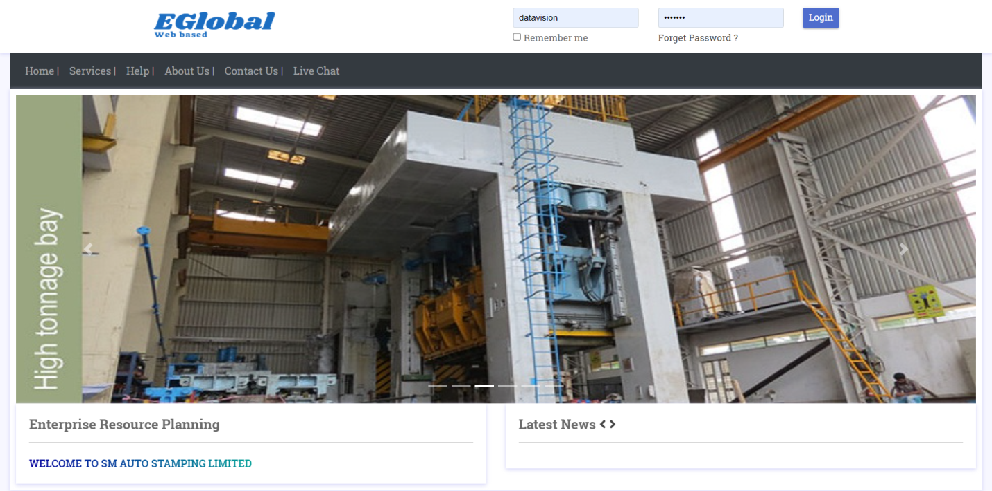
Login

Slide 99
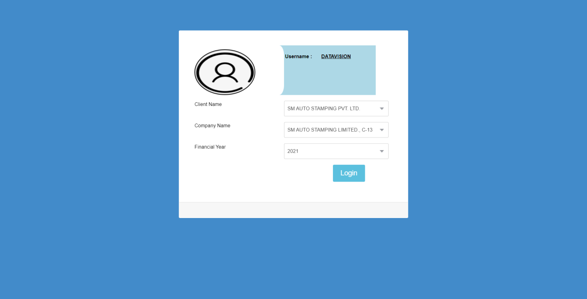
Select Company:

Slide 100
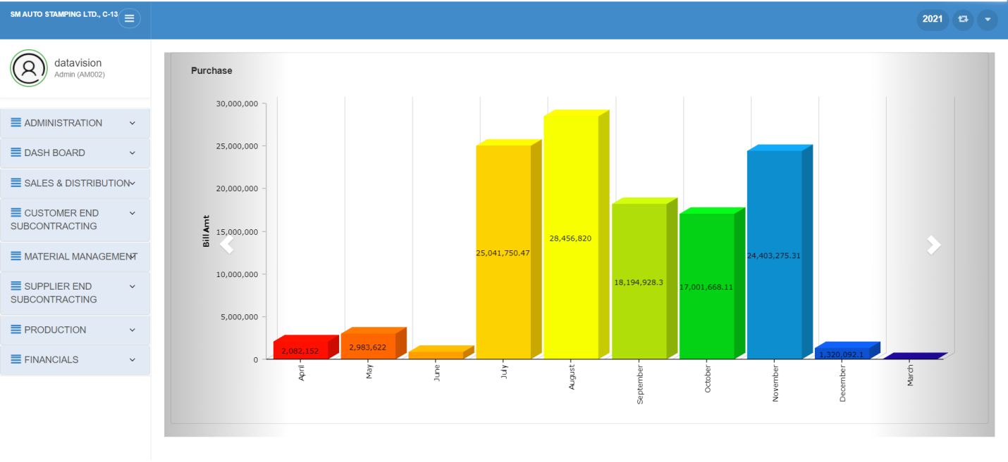
Admin Dashboard:

Slide 101
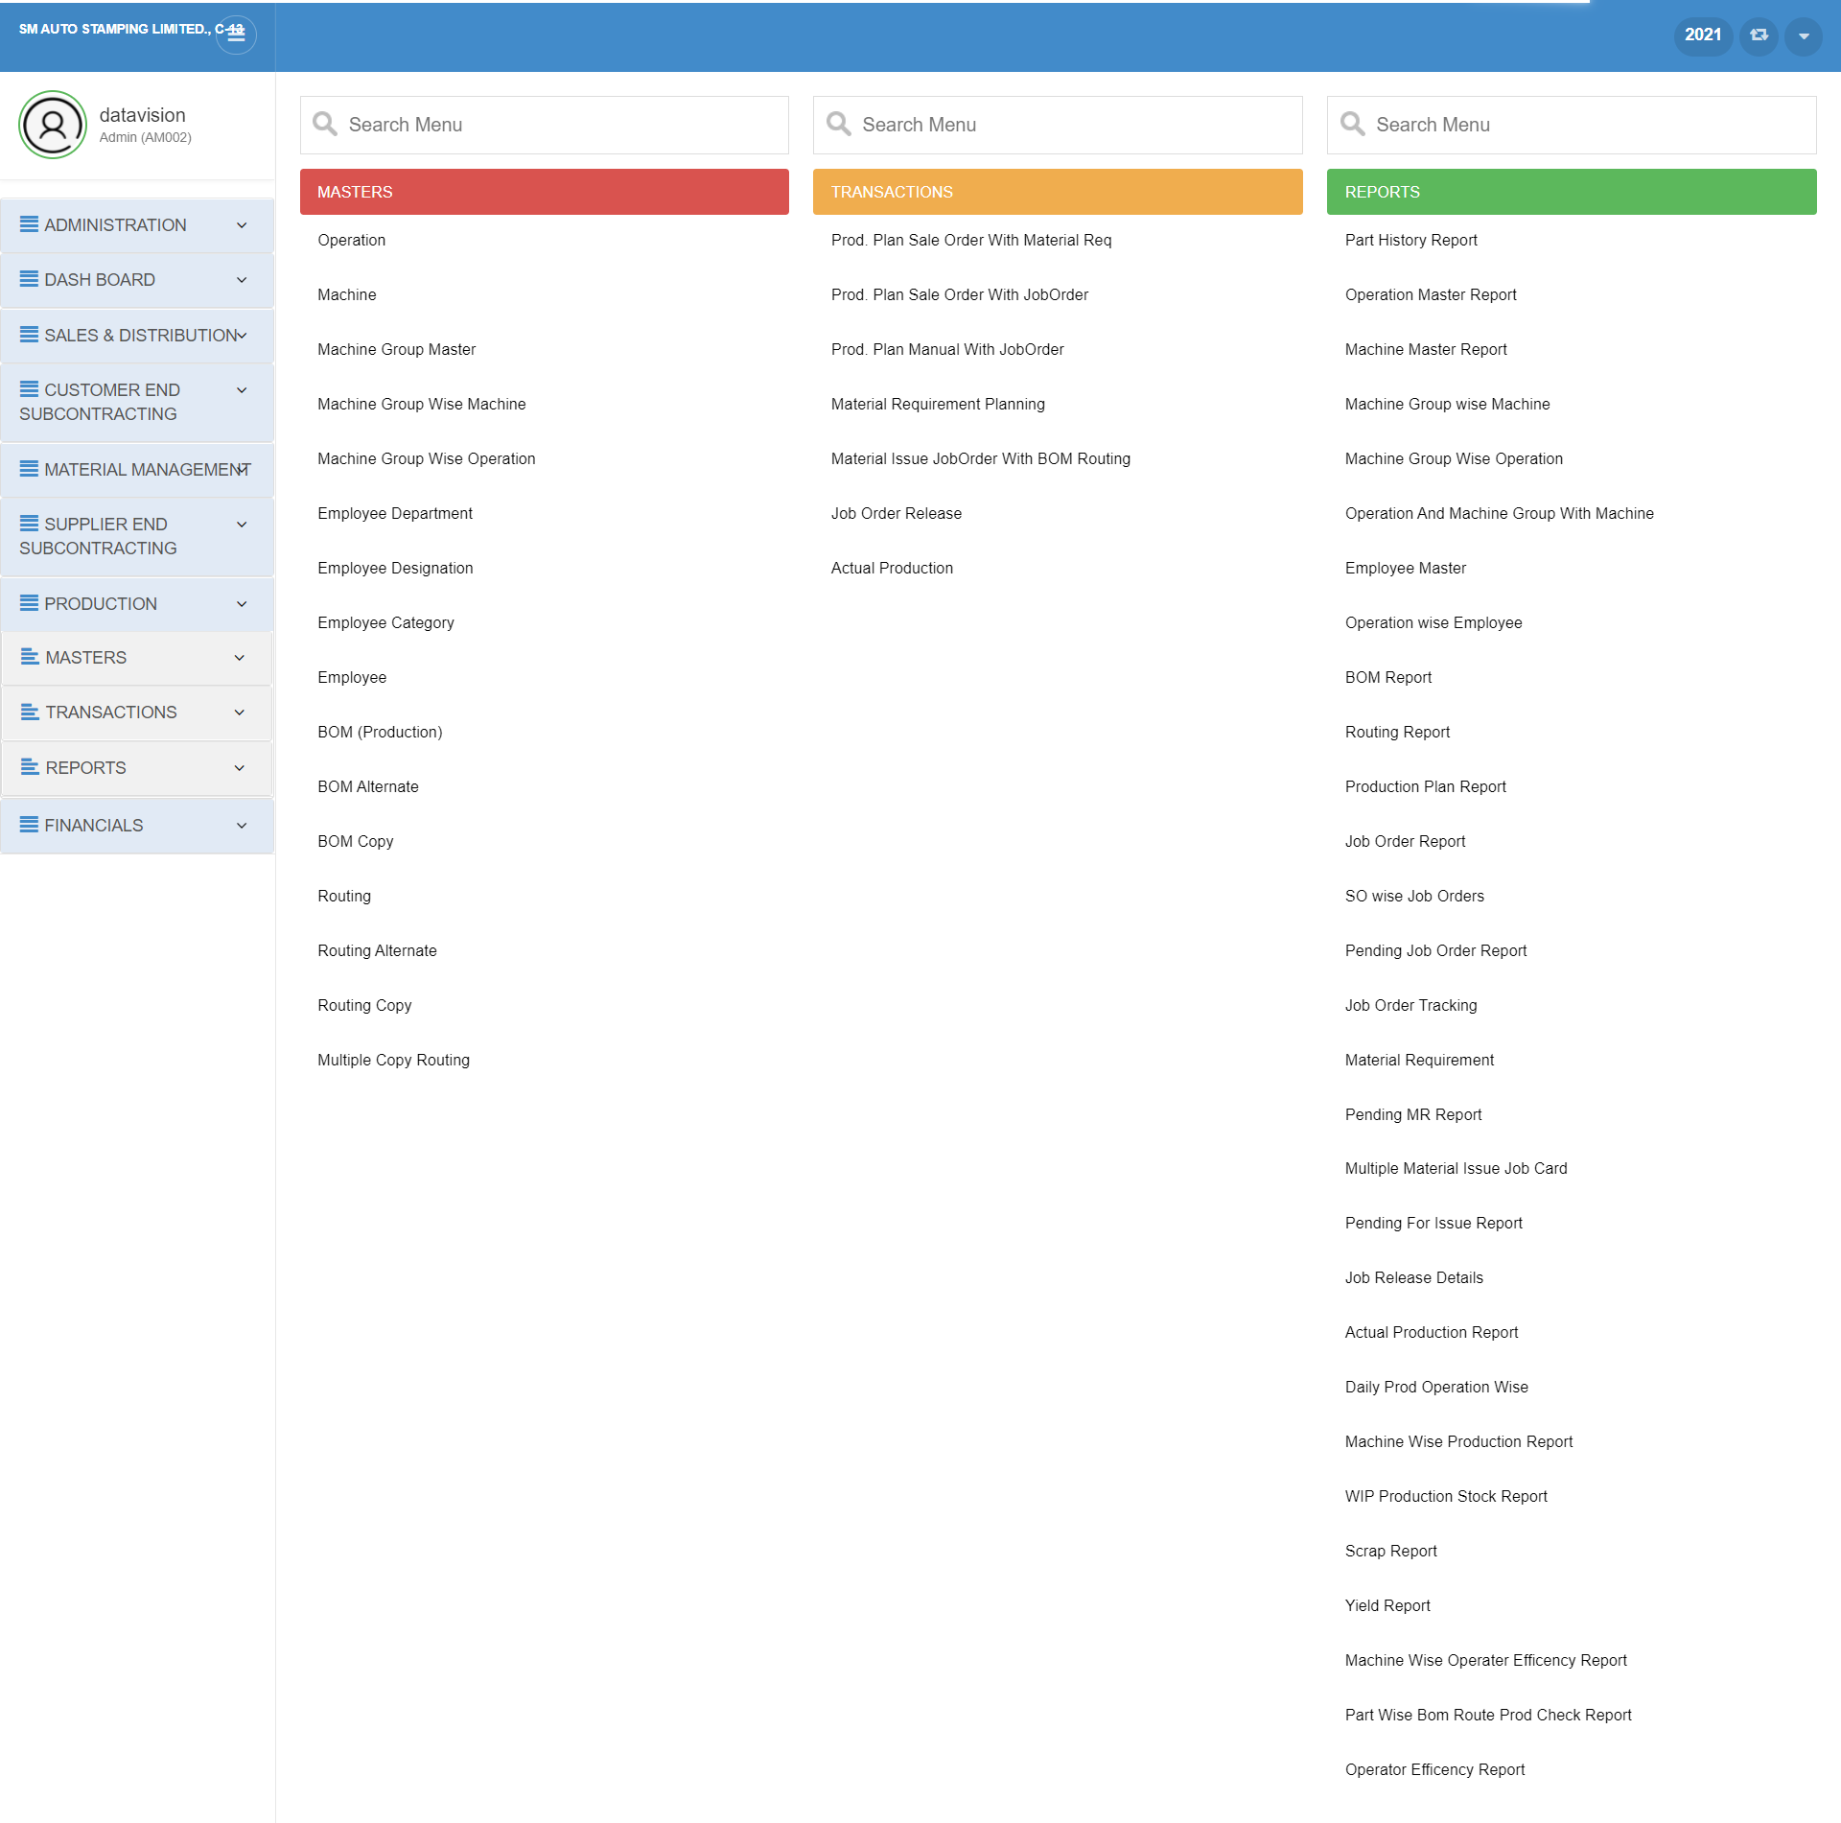
Menu:

Slide 102
Production Module
Master Forms

Slide 103
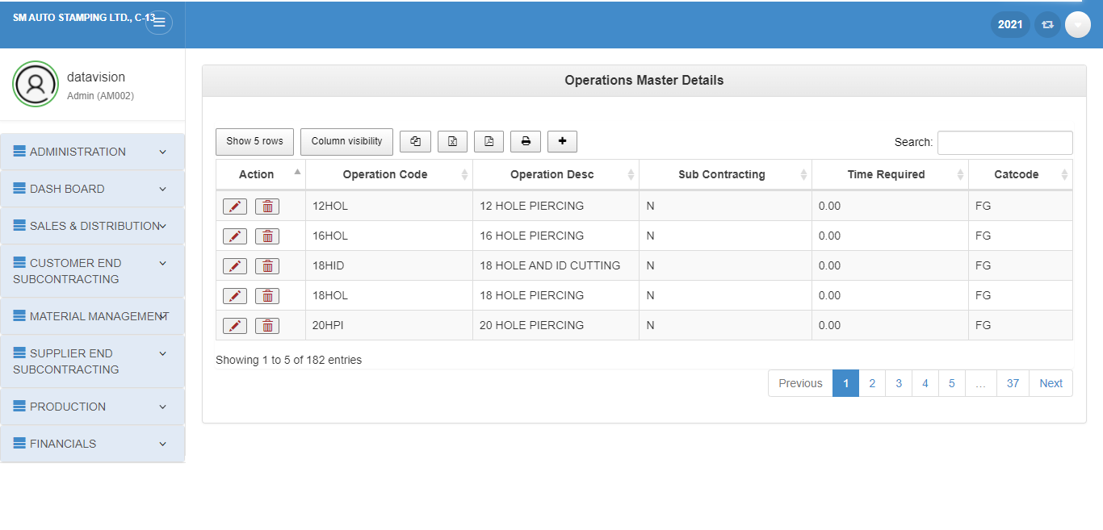
Operation Master:
1.insert
2.update
3.Delete

Slide 104
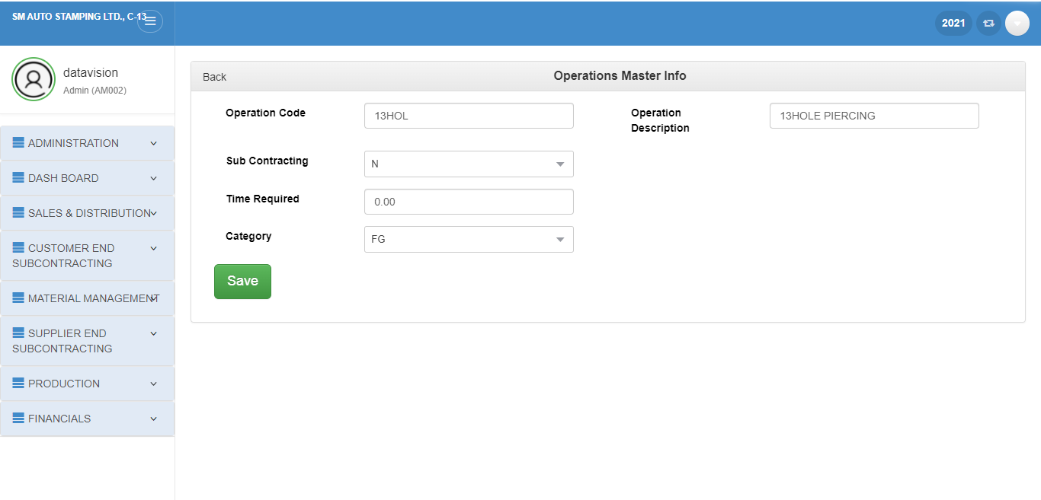
INSERT:

Slide 105
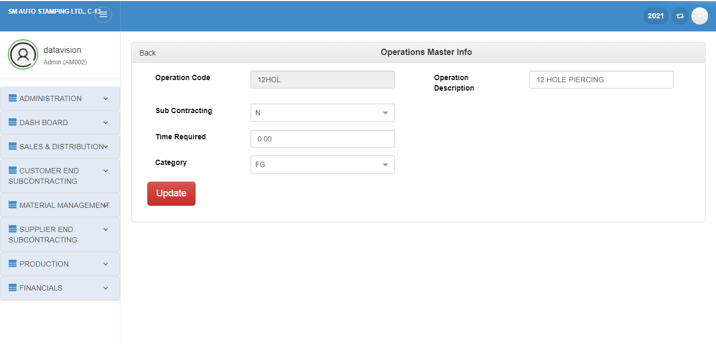
2.UPDATE:

Slide 106
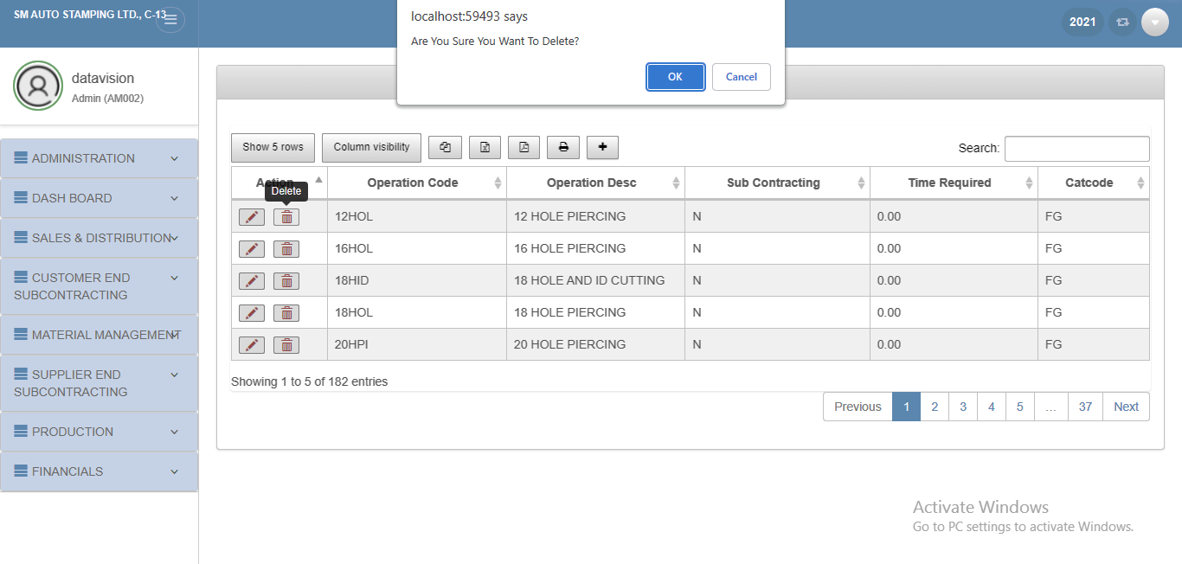
3. DELETE:

Slide 107
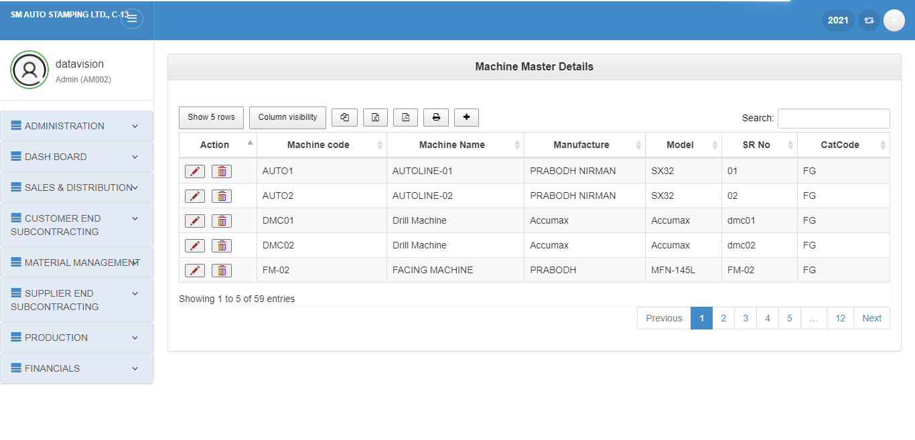
Machine
1.Insert
2.Update
3.Delete

Slide 108
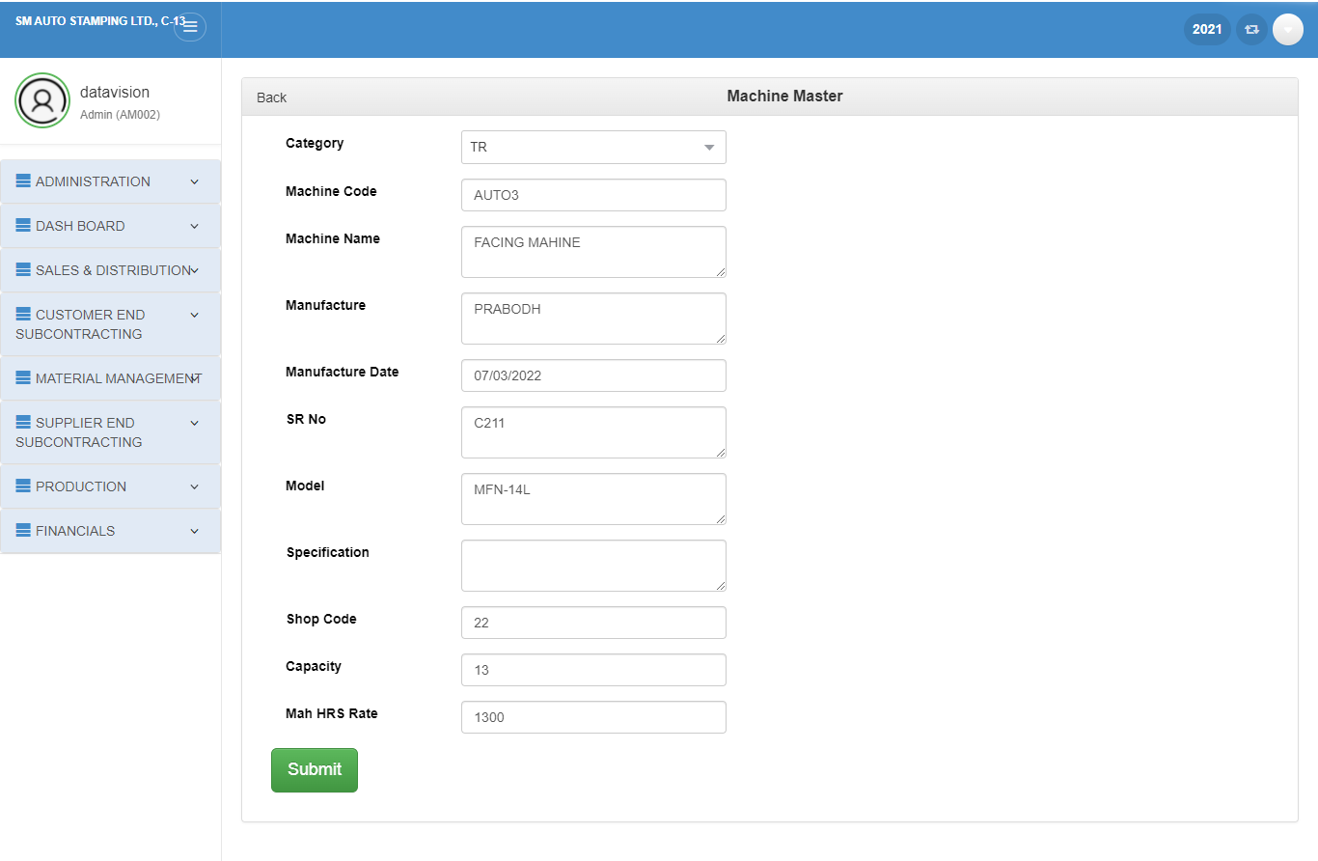
1. INSERT:

Slide 109
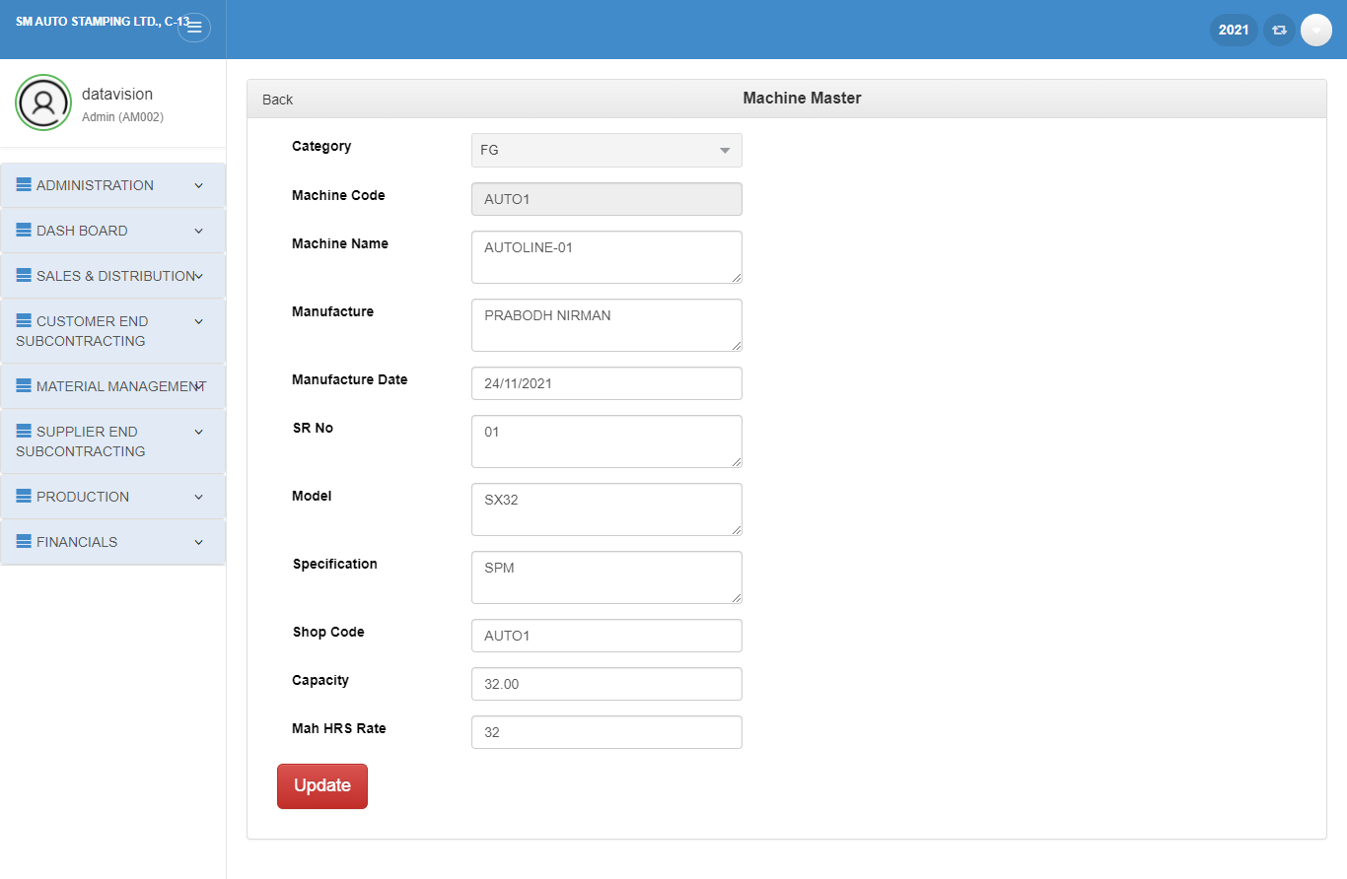
2.UPDATE

Slide 110
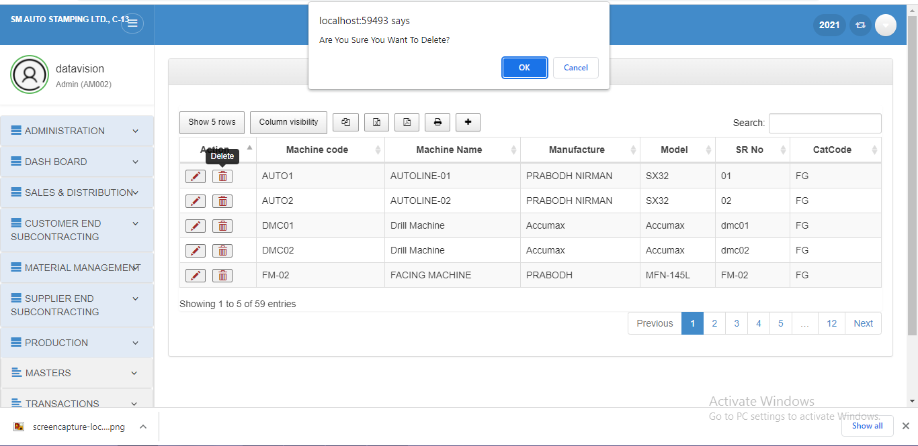
3.DELETE:

Slide 111
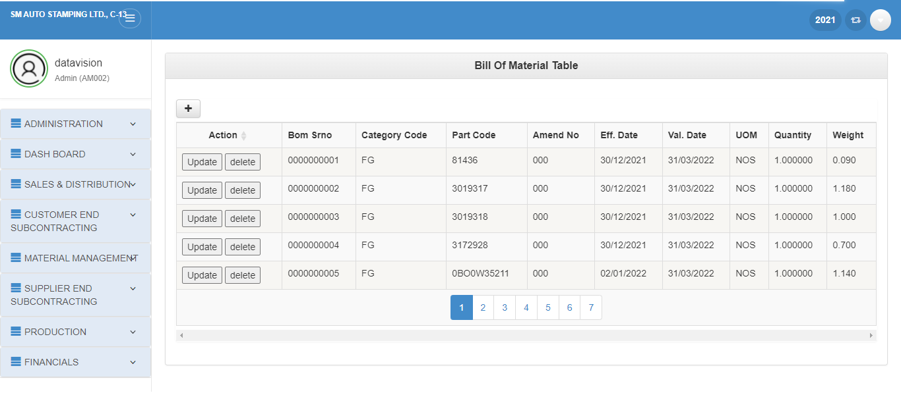
Bill of material:
1.Insert
3.Delete
2.Update

Slide 112
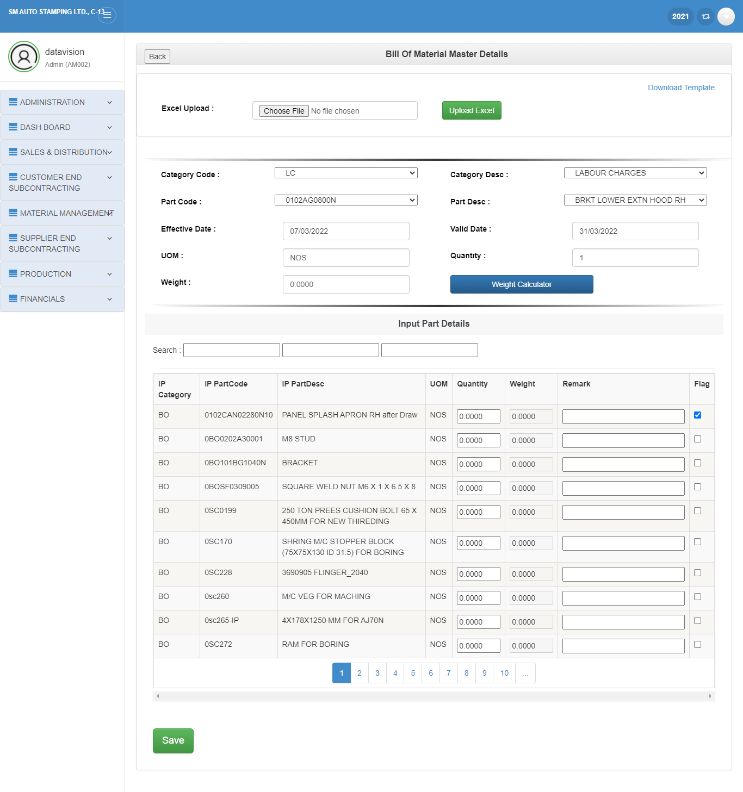
1. INSERT:

Slide 113
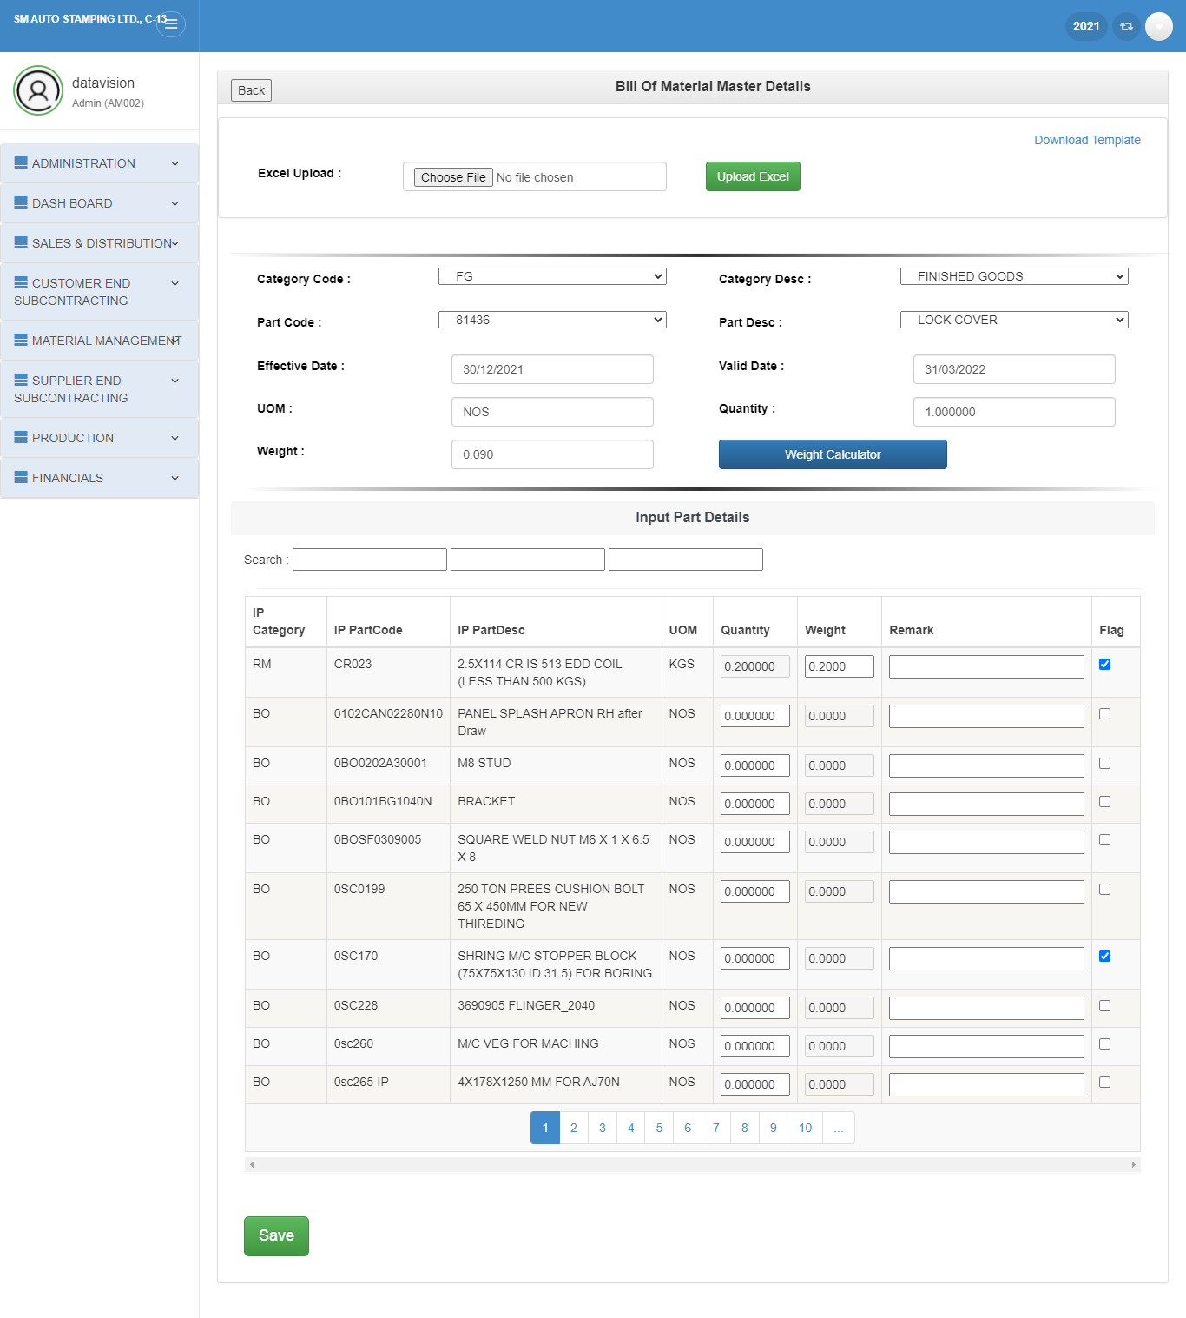
2. UPDATE:

Slide 114
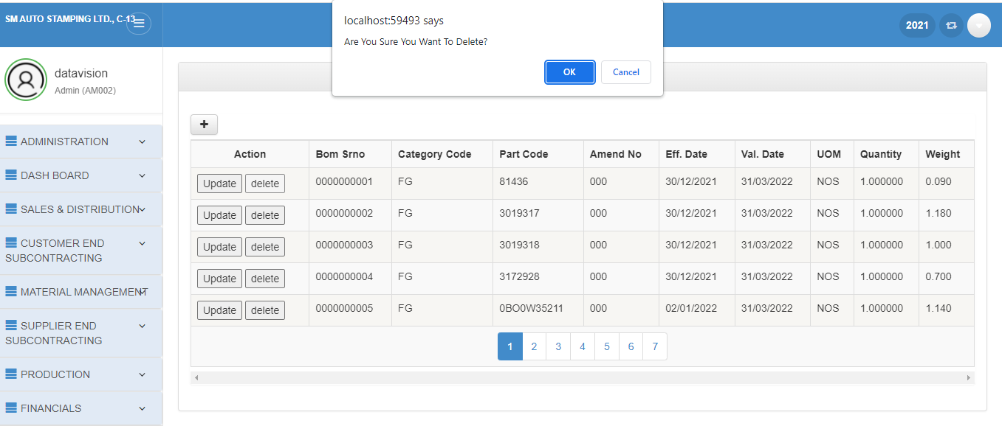
3. DELETE:

Slide 115
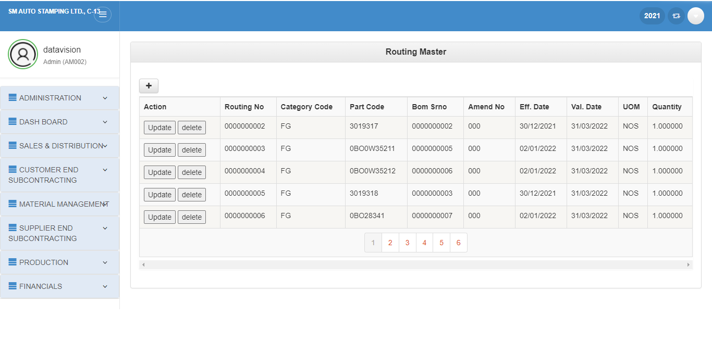
Routing:
1.Insert
2.Update
3.Delete

Slide 116
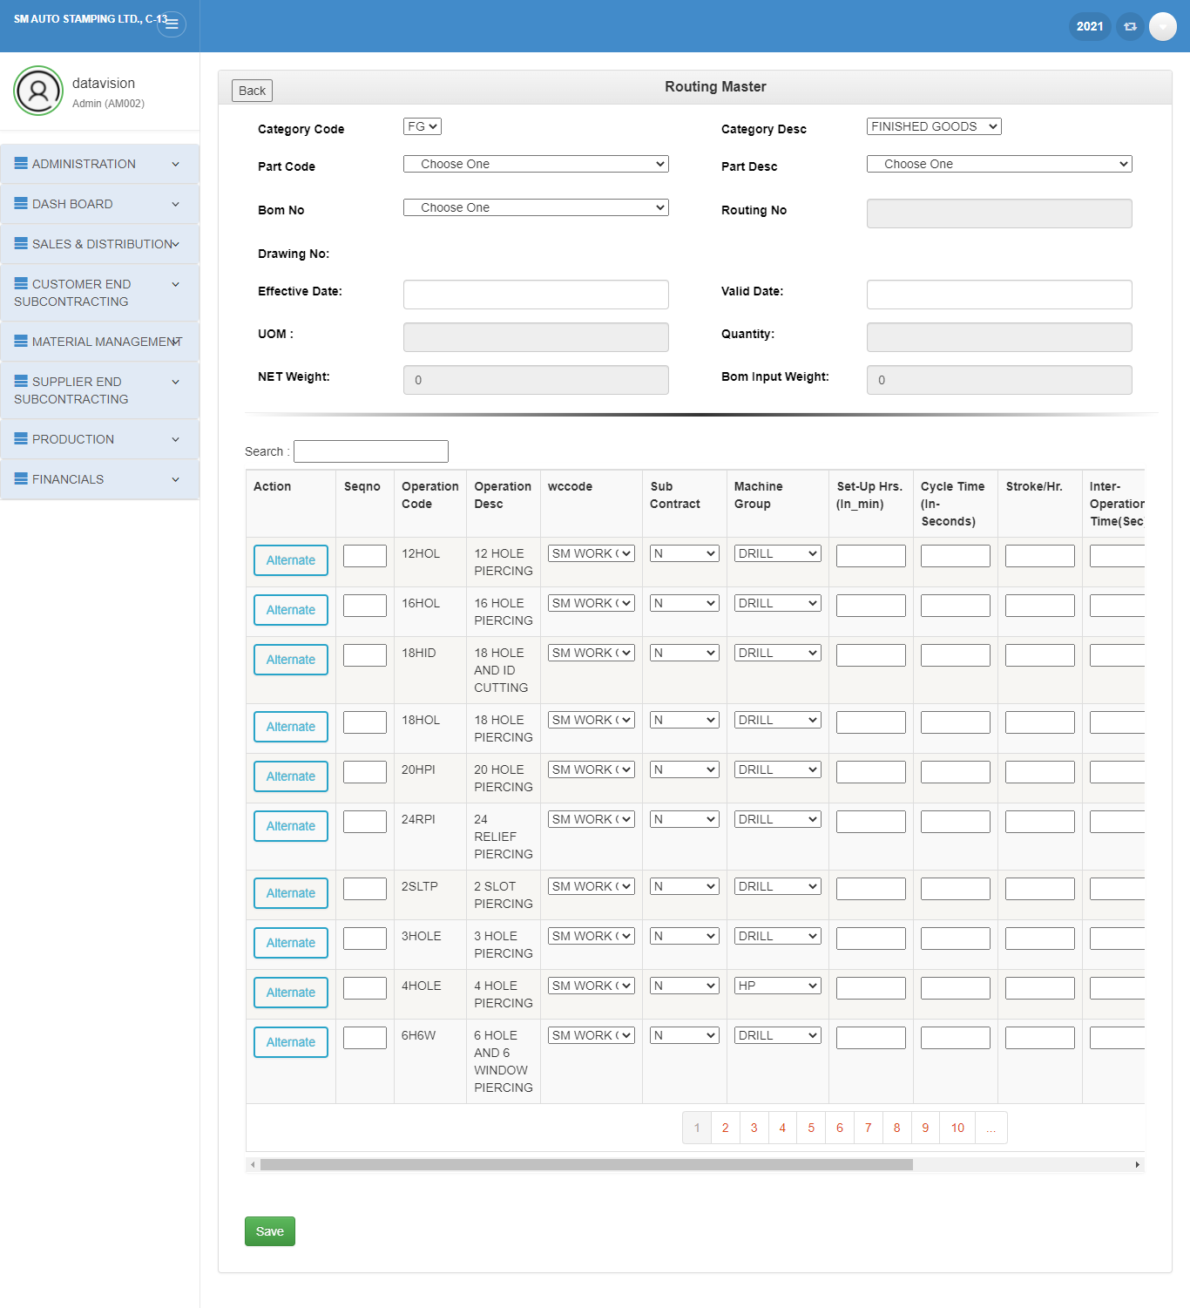
1. INSERT:

Slide 117
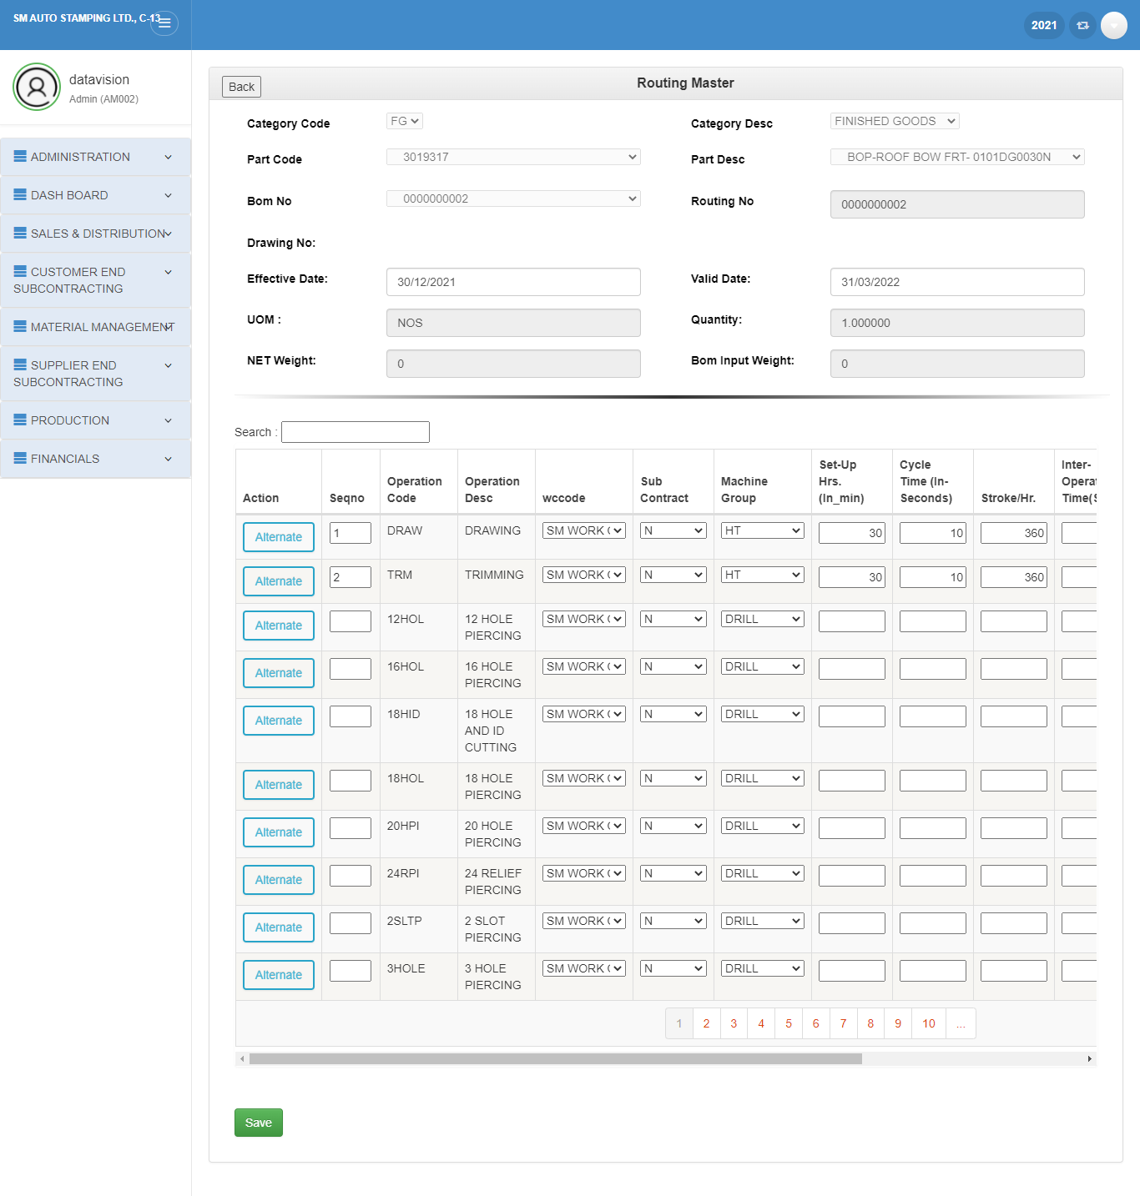
2. UPDATE

Slide 118
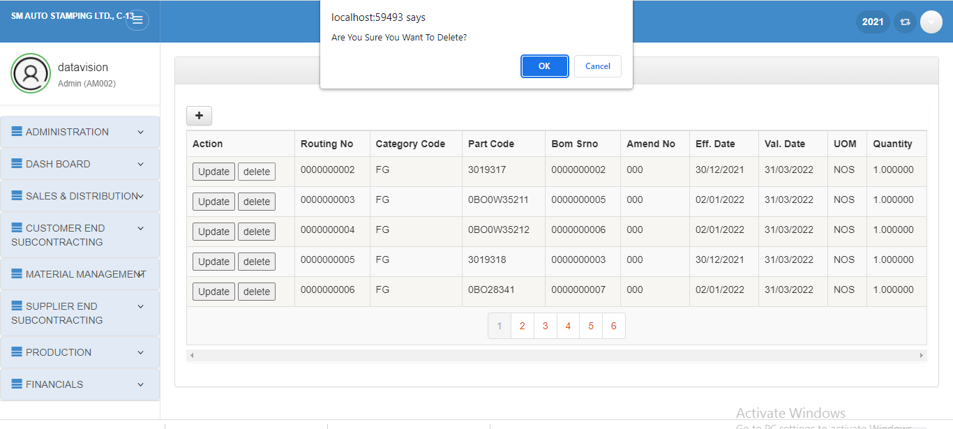
3. DELETE:

Slide 119
Production Module
Transaction Forms

Slide 120
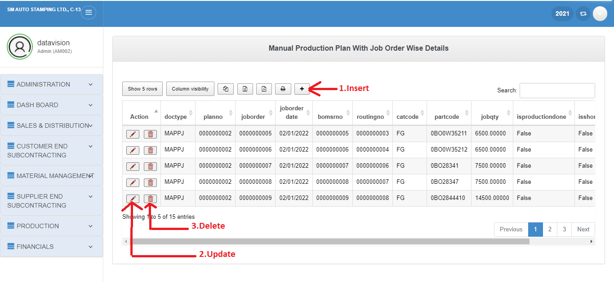
Production plan manual with job order

Slide 121
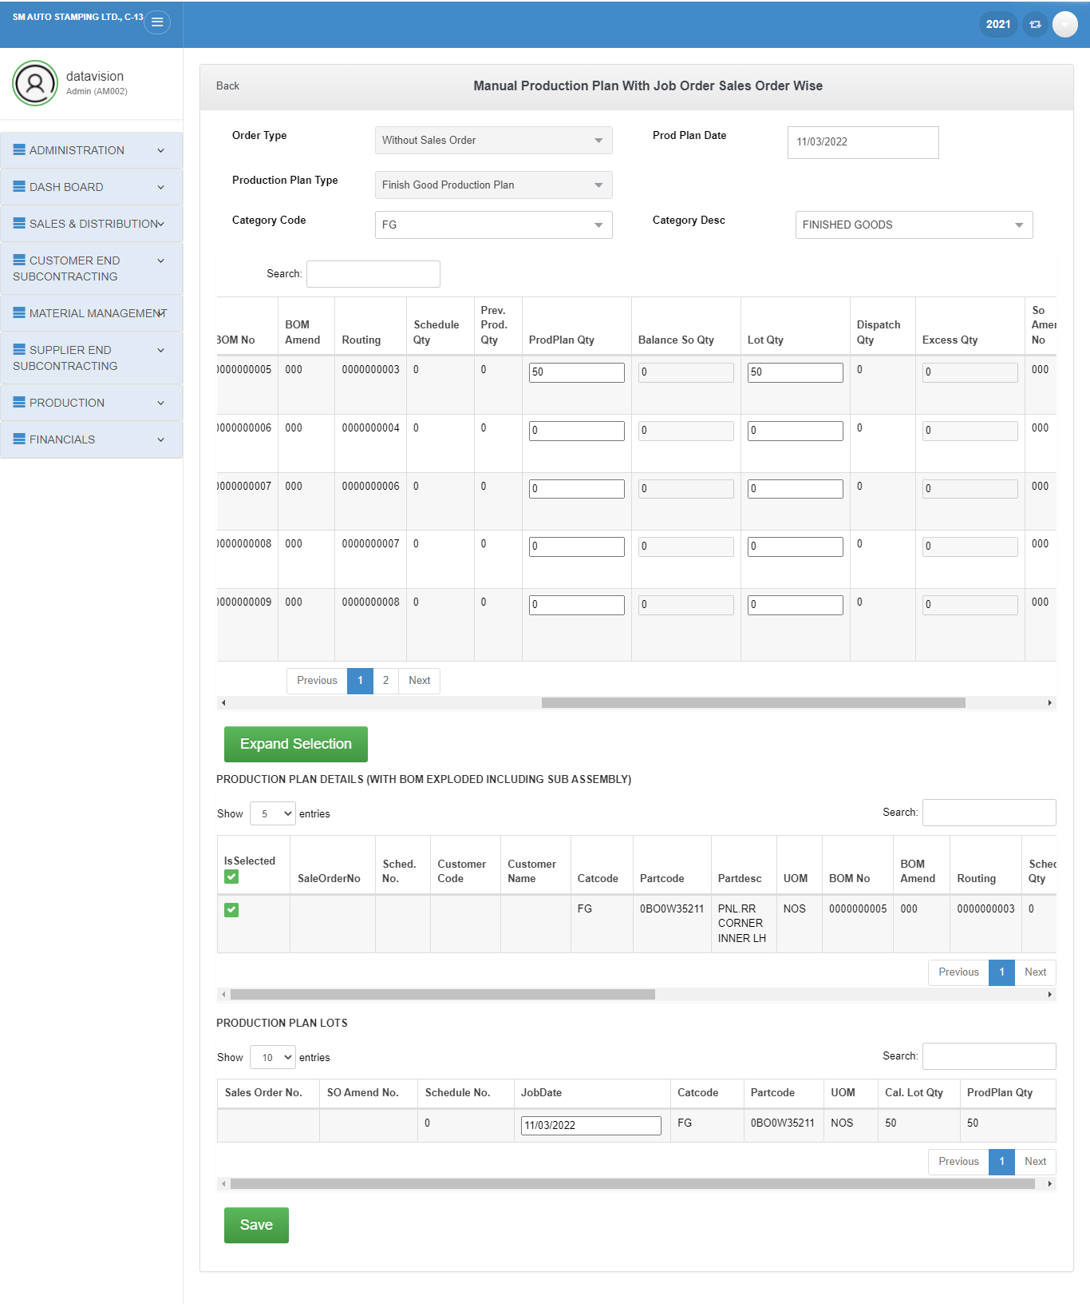
1. INSERT:

Slide 122
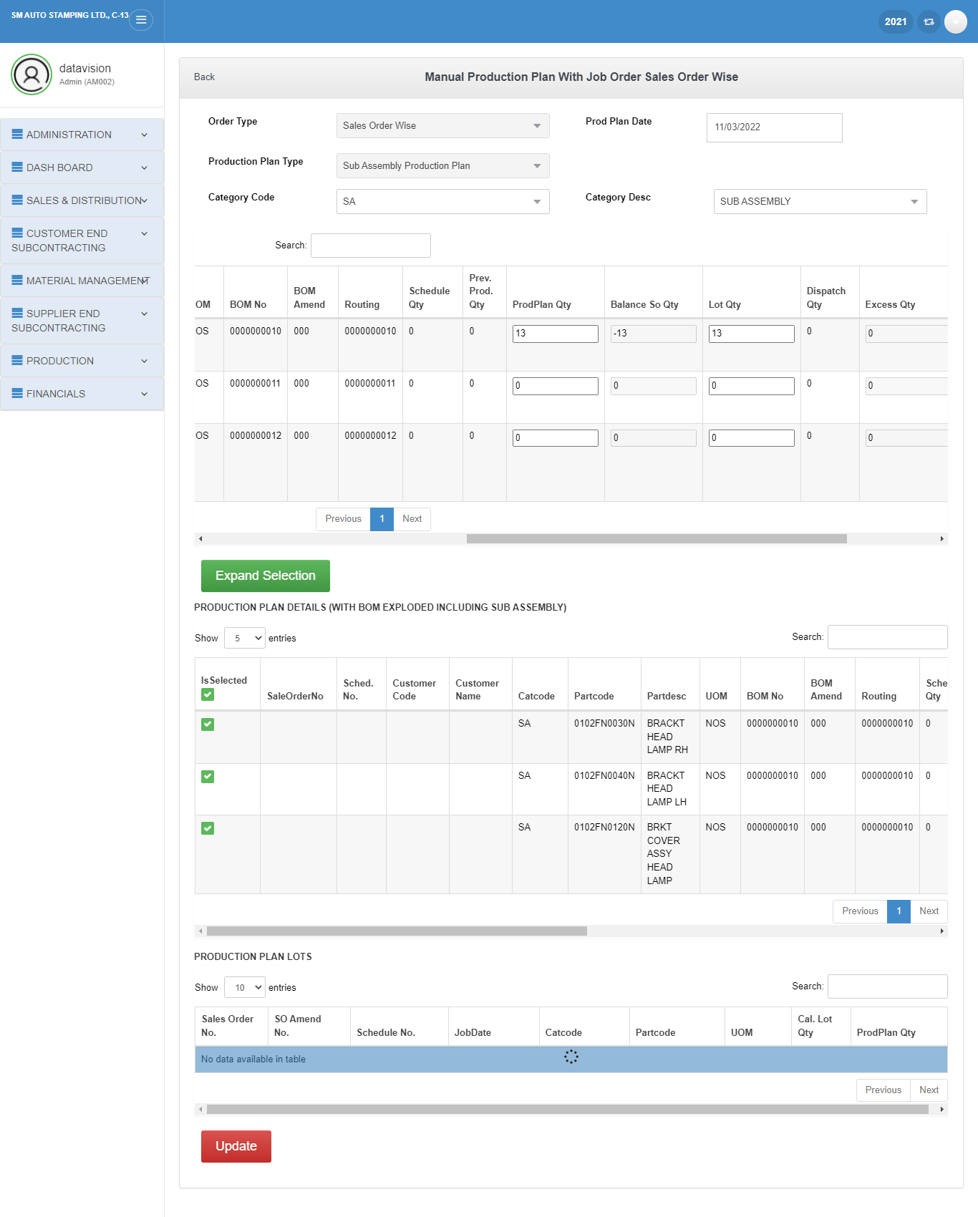
2. UPDATE:

Slide 123
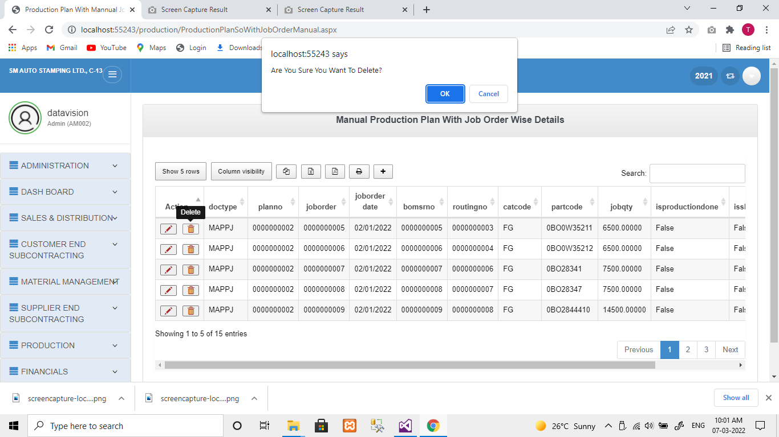
3. DELETE:

Slide 124
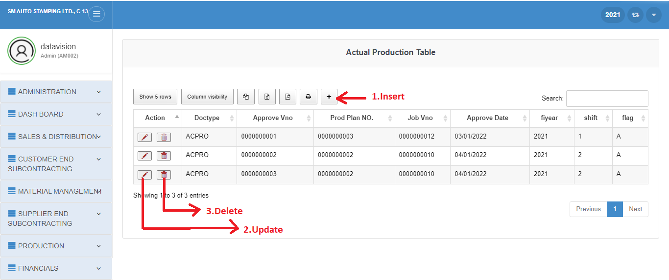
Actual Production

Slide 125
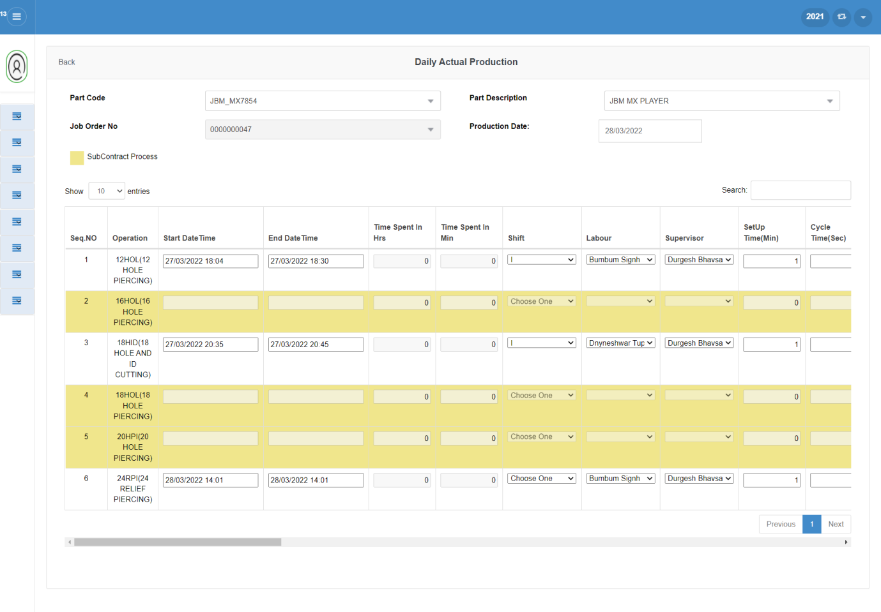
1. INSERT:

Slide 126
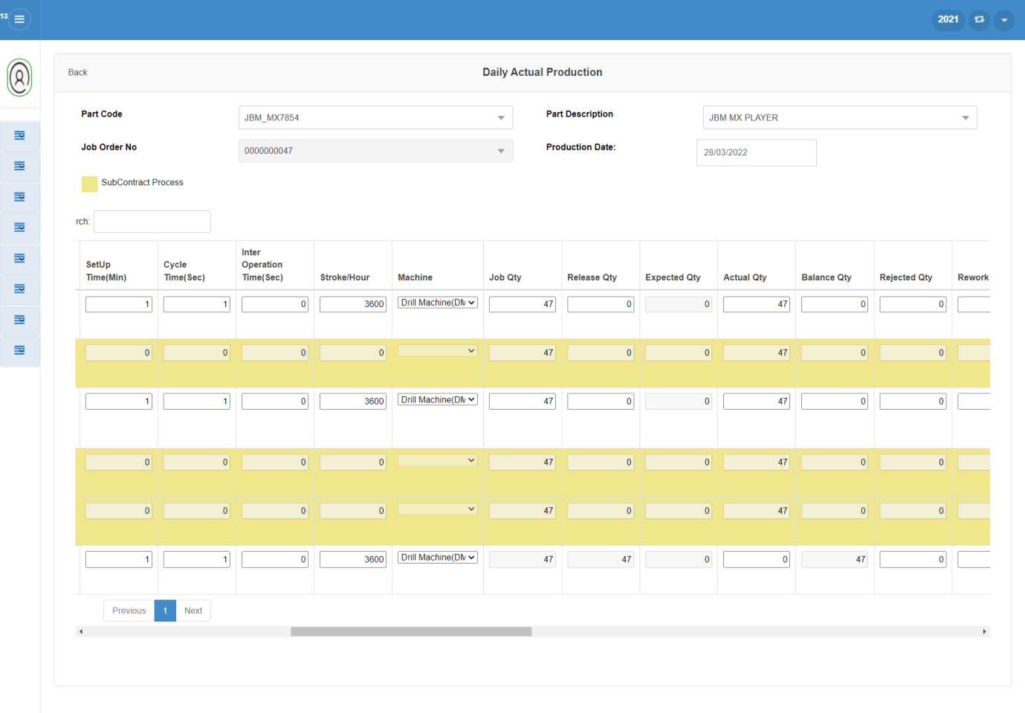

Slide 127
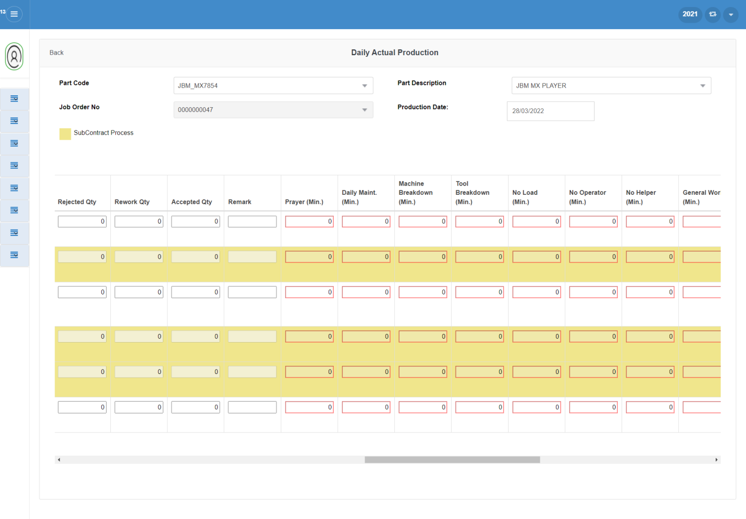

Slide 128
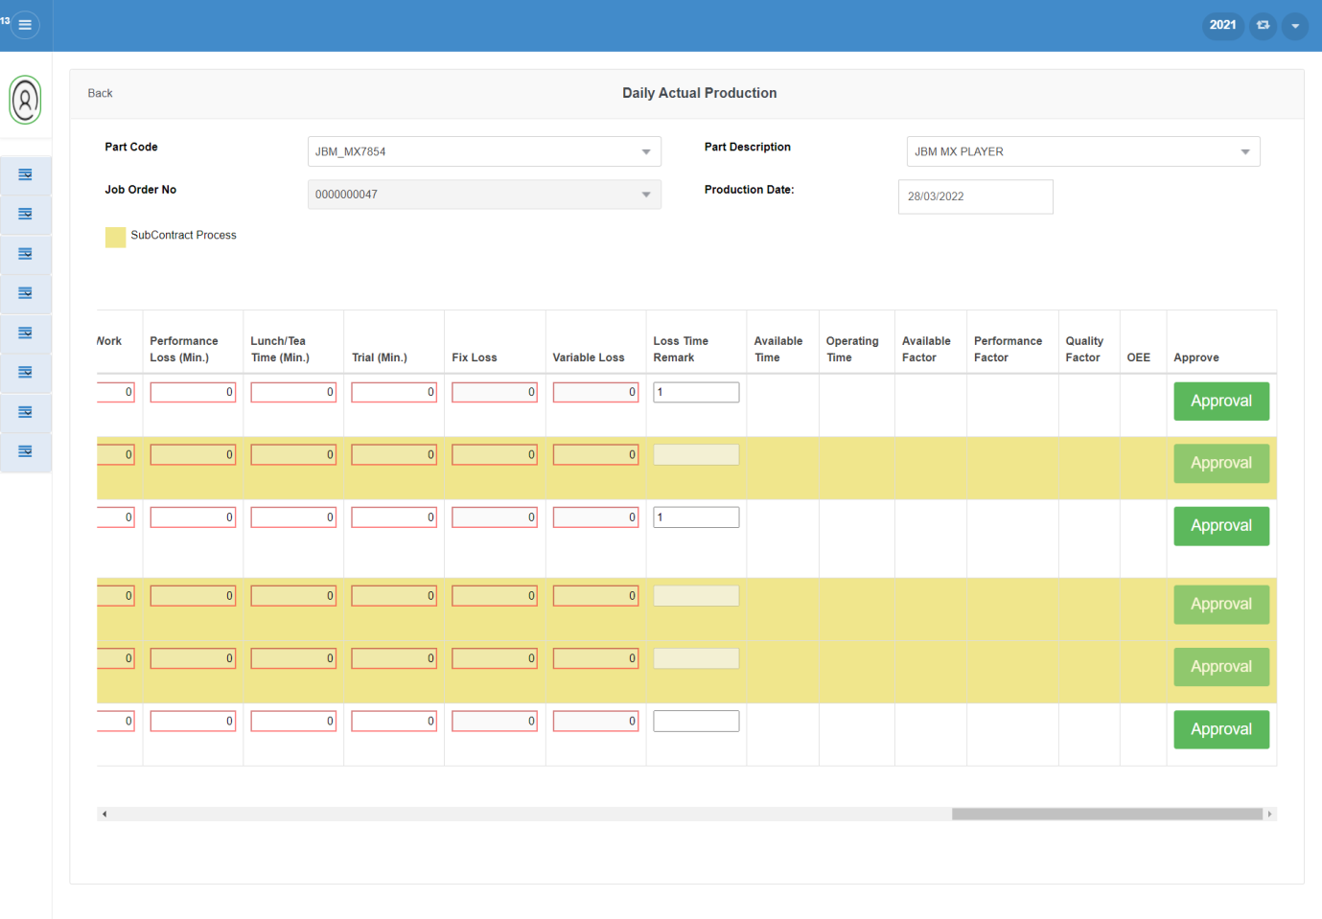

Slide 129
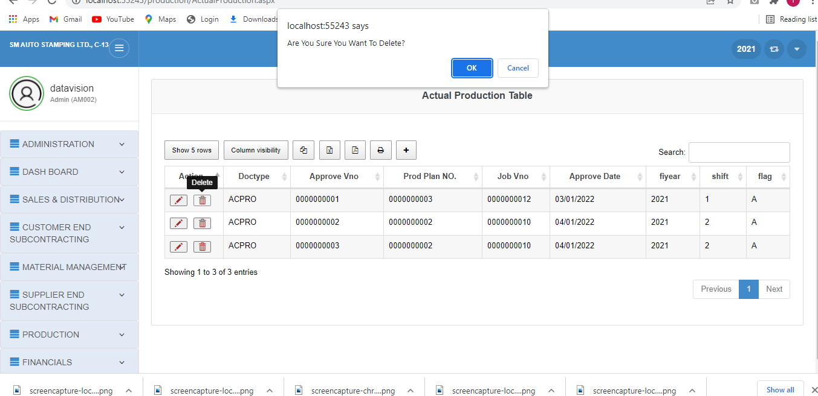
Delete:

Slide 130
Production Module
Report Forms

Slide 131
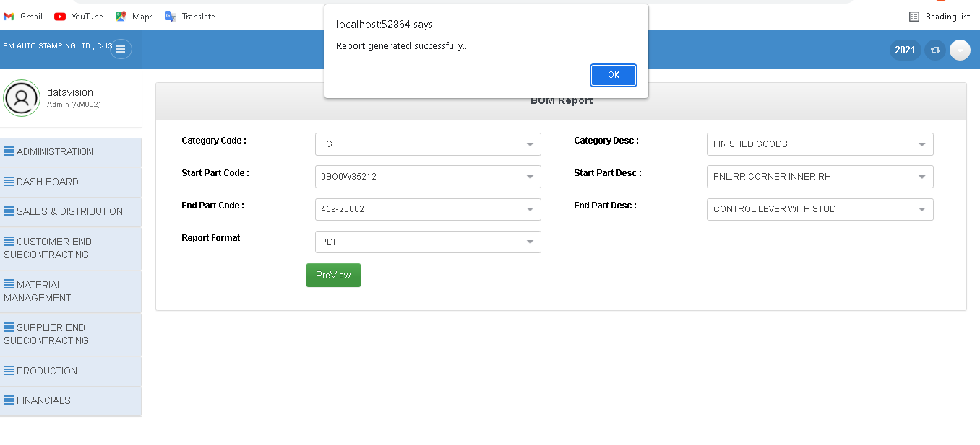
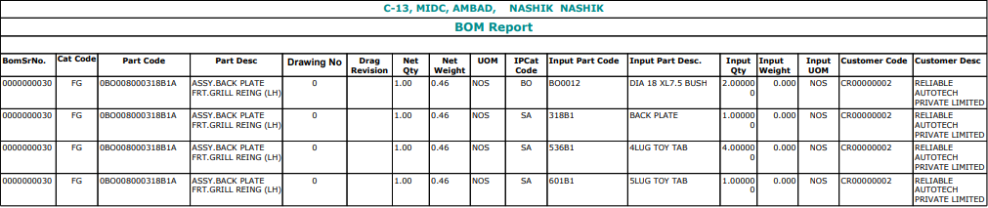
BOM Report

Slide 132
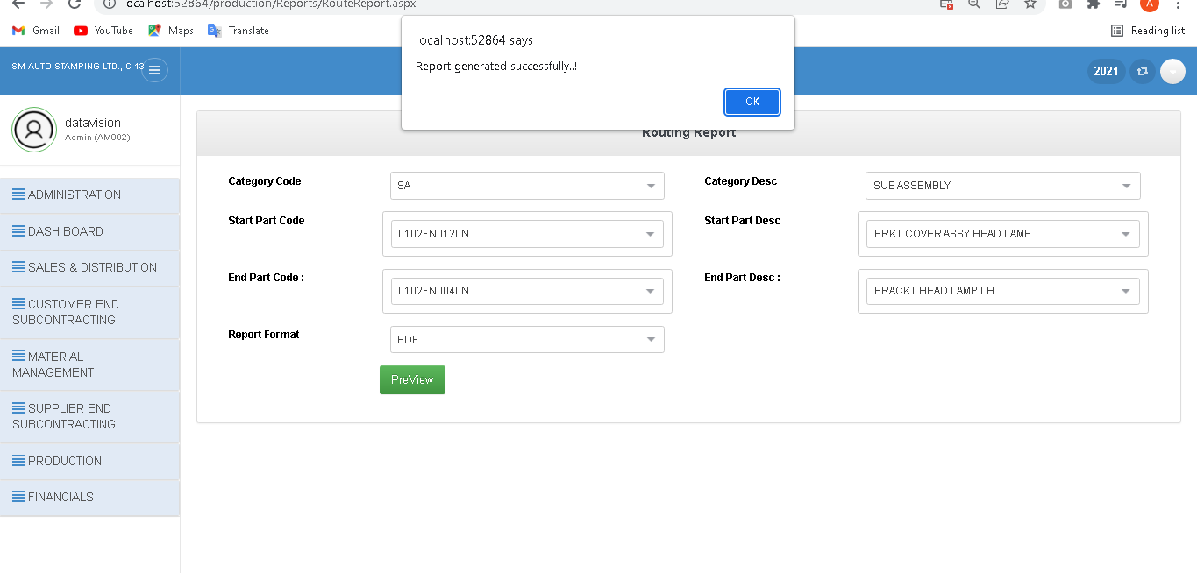
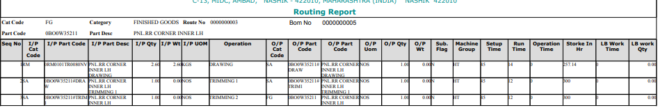
Routing Report

Slide 133
1. The cost of ERP Software, planning, customization, configuration, testing, implementation, etc. is too high. 2. ERP deployments are highly time-consuming – projects may take 1-3 years (or more) to get completed and fully functional. 3. Too little customization may not integrate the ERP system with the business process & too much customization may slow down the project and make it difficult to upgrade. 4. The cost savings/payback may not be realized immediately after the ERP implementation & it is quite difficult to measure the same. 5. The participation of users is very important for successful implementation of ERP projects – hence, exhaustive user training and simple user interface might be critical. But ERP systems are generally difficult to learn (and use). 6. Migration of existing data to the new ERP systems is difficult (or impossible) to achieve. Integrating ERP systems with other stand alone software systems is equally difficult (if possible). These activities may consume a lot of time, money & resources, if attempted
Limitation /Drawback

Slide 134
CONClUSION
1. Working on this project was a good experience. From this project I understood the need of system analysis, planning and designing and also flow of running system.
2. Also the completion if this project helps me to understand the actual working of industry. From this project I also learn how to complete different tasks simultaneously so that target can be achieved.
3. We summarize the progress with respect to the main objectives of the project.
User-friendly GUI, Better compatibility.
4. Reduces all the paper work and making digitalize

Slide 135
FUTURE SCOPE
Whenever we talk about IT project they can be scaled to infinite level. There’s always a scope of improvement in IT project. We took care of core functionality but in the race of available substitutes we have to upgrade our Application and have to launch it with improved features-
1.Making android Application for SM Web ERP System where user can access system from anywhere and anytime.
2.System Issue tracking.
3.Customer Support portal for solving problems fastly.
We can predicate that our project will help the user for doing their computation fast in compare to the manual work. Also, that our project is successful for those user that have little knowledge about the computer

Slide 136
Bibliography
Reference Books:
McGraw Hill: C# 4.0 The Complete Reference
ASP.NET 4 in C# and VB – Bill Evjen, Scott Hanselman, Davin Rader
SQL Server The Complete Reference – Gayle Coffman
Websites:
https://www.gaposm.com/tag/project-report-on-erp/
https://www.syspro.com/product/syspro-erp/applications/production-management/
https://www.scribd.com/document/162448147/105987116-a-Project-Report-on-ERP
http://www.open-source-erp-site.com/erp-production-planning-module.html
http://www.visibility.com/erpModule_materialPlanning.html
https://www.slideshare.net/rajeevsharan/production-module
http://www.excitingip.com/2010/advantages-disadvantages-of-erp-enterprise-resource- planning-systems/

Slide 137
THANK YOU!!!

